Slide 1
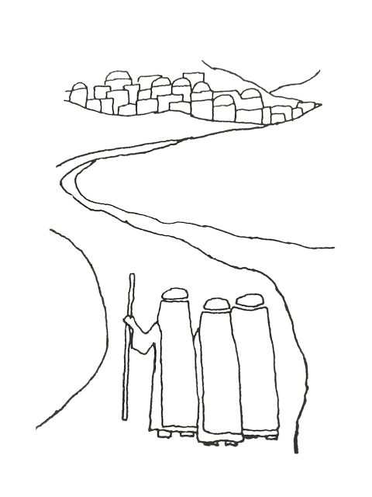
Presented by Initiation Ministry Partners
in collaboration with
The Office of Evangelization and Discipleship
HOW TO CREATE, FORM AND NURTURE AN OCIA TEAM
OCTOBER 14, 2025 Terry Zobel

Slide 2
This workshop is divided into 3 parts:
Part I. How to Create an OCIA Team
Part II. How to Form an OCIA Team
Part III. How to Nurture an OCIA Team

Slide 3
As advertised (!), the flier promised that you will:
Understand the roles, responsibilities and qualities needed to build a successful OCIA Team
Learn about what methods and means of formation you can tap into to equip your team
Learn to recognize the signs of a healthy team, how to avoid burnout, and how to strengthen the gifts each person brings to this ministry
Note: the presentation, along with the PowerPoint slides, will be available within a few days on our website.

Slide 4
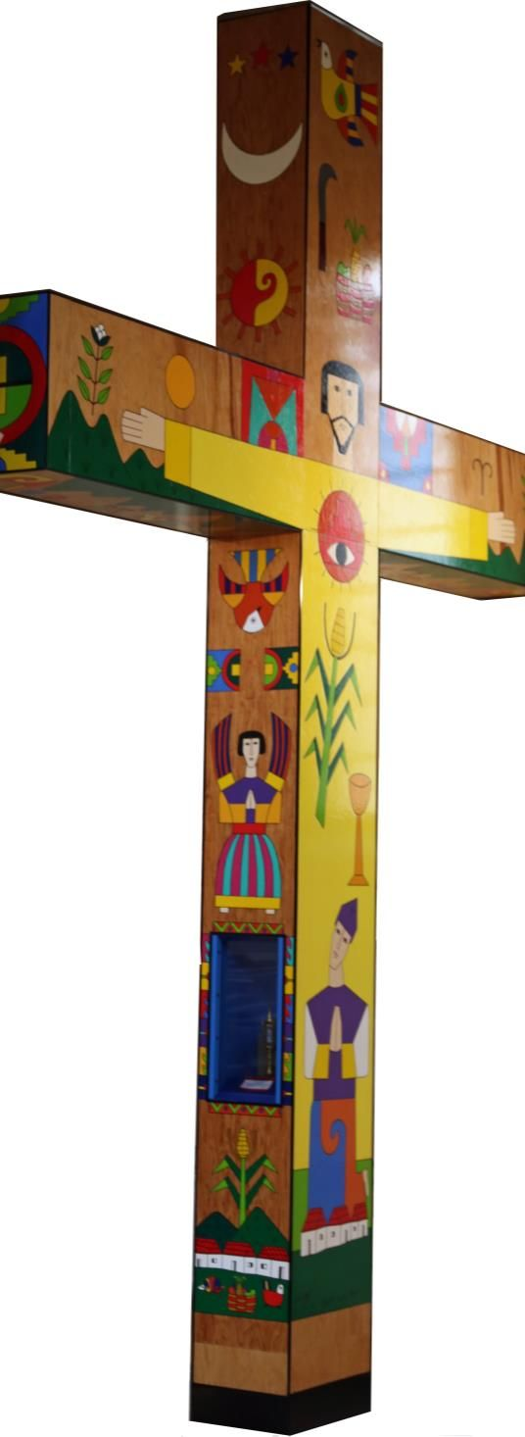
Prophets of a Future not Our Own
It helps, now and then, to step back
and take the long view.
The Kingdom is not only beyond our efforts;
it is even beyond our vision.
We accomplish in our lifetime
only a fraction of the magnificent enterprise
that is God’s work.
Nothing we do is complete,
which is another way of saying that the
kingdom always lies beyond us.
(continued)

Slide 5
No statement says all that could be said.
No prayer fully expresses our faith.
No confession brings perfection.
No pastoral visit brings wholeness.
No program accomplishes the church’s mission.
No set of goals and objectives includes everything.
This is what we are about.
We plant the seeds that one day will grow.
We water the seeds already planted,
knowing that they hold future promise.
We lay foundations that will need further development.
We provide yeast that produces effects far beyond our capacities
Opening Prayer, cont.

Slide 6
We cannot do everything
and there is a sense of liberation in realizing that.
This enables us to do something and do it well.
It may be incomplete, but it is a beginning,
a step along the way,
an opportunity for the Lord’s grace to enter and do the rest.
We may never see the end results,
but that is the difference between the master builder and the worker.
We are workers, not master builders; ministers, not messiahs.
We are prophets of a future not our own.
Opening Prayer, cont.

Slide 7
How I got involved in this ministry
Part I: How to Create an OCIA Team

Slide 8
A. Some Assumptions/Principles
The Catechumenate belongs to the parish.
OCIA is based on the principle that the community hands on the Tradition.
The primary minister is the community – all the baptized—the whole community—all the faithful.
Nowhere in the Rite does it use the word “Team”! That’s an American creation to implement the Rite.
Continued

Slide 9
A. Some Assumptions/Principles, continued…
3) The gifts needed by the community will be given.
Our job is to call forth and enable the gifts already given and allow them to blossom.
The key principle is to adapt for your situation.
large parish, small parish, city parish, suburban parish, rural parish,
African American parish, Hispanic parish, Vietnamese parish,
Campus ministry, etc.

Slide 10
B. Ministries and Offices
On pages 17-19 of the new OCIA, the section heading is Ministries and Offices. It lists them in this order:
The People of God – all the baptized. “Every disciple of Christ is individually obliged to spread the faith.” It then goes on to list how the People of God do that in each period of the OCIA.
Sponsors and Godparents
Bishop
Priests
Deacons
Catechists

Slide 11
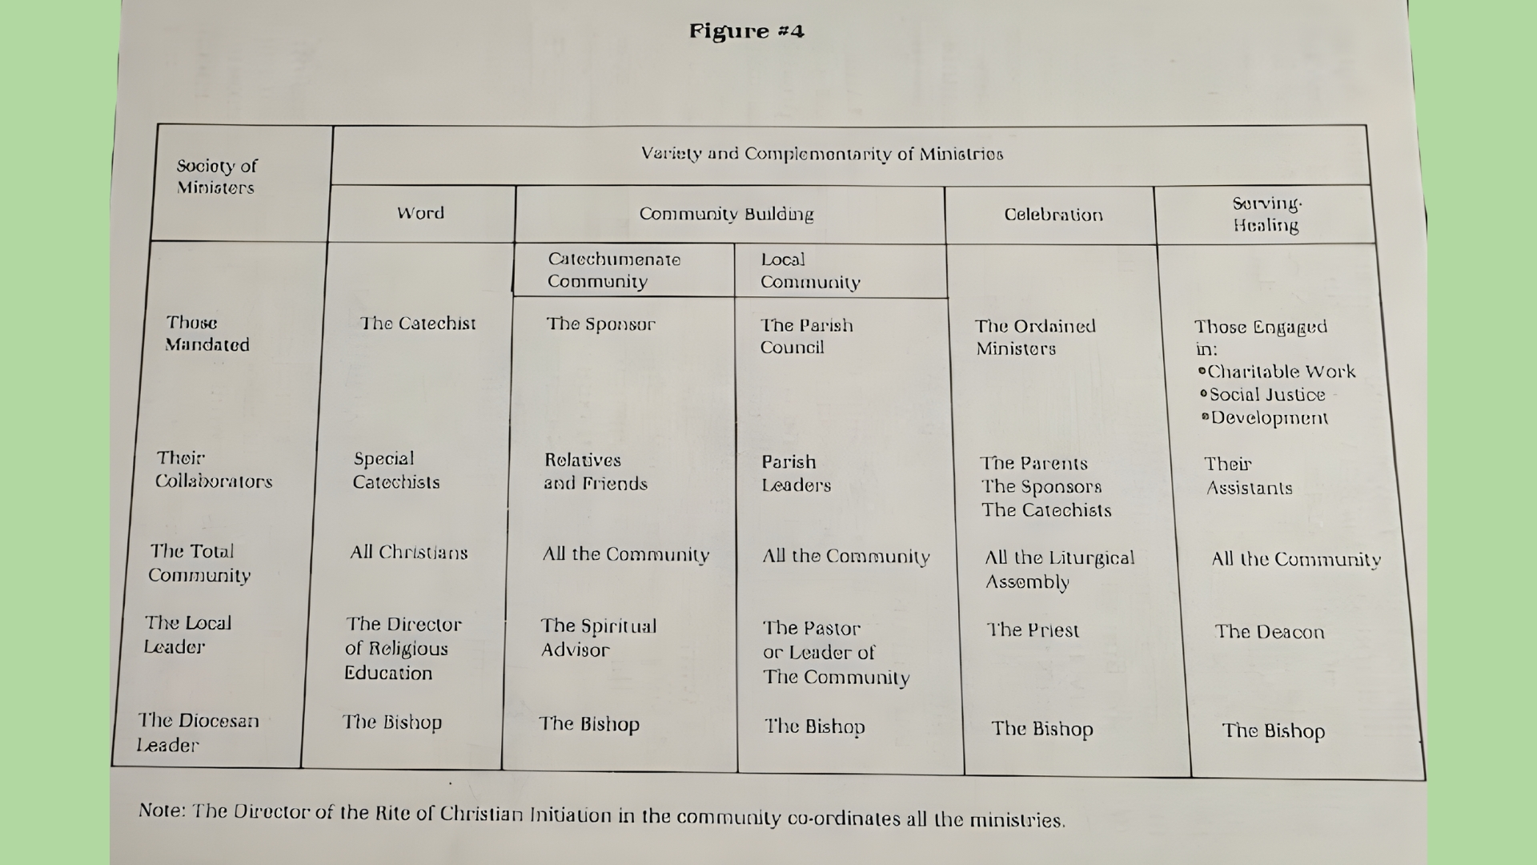

Slide 12
C. Ministries that have grown up through practice/implementation in the U.S.
1) Coordinator/Director/Pastor
2) Hospitality
3) Sponsor Coordinator
4) Liturgy Planner and Coordinator
5) Prayer Planner
6) Prayer Leader
7) Specialized Catechists for each period:
Inquiry
Catechumenate
Dismissal Facilitators
Purification and Enlightenment
Mystagogia
8) Interviewers
9) Communication
10) Retreat(s) planner
11) Spiritual Director
12) The Coordinator (and catechists, etc.) of the OCIA adapted for Children
13) The Coordinator (and catechists, etc.) who work in different languages

Slide 13
Discern needs
Discern gifts and qualities of Team members:
BLT (Basic Lay Person)
Persons of Faith and Prayer (lives a life of faith, hope, love, i.e., a giving person)
Community Builder (knows relationships are important)
Welcomer (doesn’t know a stranger)
Reminder of the Living Tradition (prays the Rosary, Stations of the Cross, Adoration)
A Continually Converting Person (is willing to be challenged by the Gospel)
A Searcher/Questioner (asks the hard questions, doesn’t accept things at face-value, willing to wrestle with God)
D. How to Select a Team

Slide 14
A Good Sense of Humor
A Witness to the Gospel (can speak about their experience of God)
Justice Oriented (reminds us that mission is the goal—not the Easter Vigil)
Flexible Organizer (doesn’t panic when things change)
Creative (comfortable with the use of symbol—right brained)
Other?
(Continued)

Slide 15




A. Skills of Effective Team Members
Part II. How to Form a Team
Awareness of Personal Faith
Awareness and Understanding of Relationship Building:
To build relationships involving welcoming, sharing, listening, and making a commitment.
To sustain relationships involves being able to handle conflict, to affirm, to direct, and to challenge.
Knowledge and Skills

Slide 16
B. Methods/Means of Formation
Speakers/workshops provided by Initiation Ministry Partners
Articles on the Initiation Ministry Partners blog
Consultation/collaboration with Initiation Ministry Partners
We’re willing to come to you!
4) Team Meetings
Involve praying together, some formation (such as articles, books) as well as planning, discerning, make course corrections, etc.
5) Team Retreats
Involve quality time to pray, reflect, learn together, to evaluate the process and to plan ahead, and — perhaps most of all—to have fun! To socialize: share meals and play together.

Slide 17
Retreat Topics I have facilitated with my team:
1985 Conversion
1986 Faith
1987 Shared Praxis
1988 Evangelization and the “New” Rite
1989 The Creed
1990 The Lord’s Prayer
1991 Spirituality and the Seasons of Adulthood
1992 Stages of Faith
1993 Conversion Observed
1994 Catechesis as Pastoral Ministry
1995 Lex Orandi/Lex Credendi
1996 One at the Table, book by Fr. Ron Oakham (concerning the previously baptized)
1997 Mystagogia
1998 Purification and Enlightenment
1999 The Catechumenate: “Spirit of the Living God at Work in Us – the Church” (included study of the new General Catechetical Directory)
Part III. How to Nurture a Team

Slide 18
2000 The Pre-catechumenate: “The Hospitality of God”
2001 Blessing
2002 Exorcism in the RCIA
2003 Liturgical Catechesis
2004 The Story of How God Has Chosen to Love the World through Me
2005 Transformative Initiation in Men and in Women (Rohr)
2006 The Power of Story
2007 Christ Lives in Me
2008 Apprenticed to Christ, book by Jerry Gallipeau
2009 The Paschal Mystery: the Pattern and the Promise
2010 “Lord, Teach Us to Pray”
2011 “The Two Major Tasks of the Spiritual Life” (Rohr)
2012 “Creating a People of the Garden”
2013 “The Year of Faith: A Call to Conversion”
2014 Tending the Rose
Cont.

Slide 19
2015 “In the beginning…”
2016 Hierarchy of Truths: Jesus’ Use of Scripture
2017 Retreat cancelled. Grandchild on the way!
2018 Grace: Noticing and Naming God’s Gifts
2019 Self-Giving Love: The Universal Call to Holiness
2020 No Retreat – COVID
2021 No Retreat – COVID
2022 Day of Reflection with SFC Leaders – “The Last Lecture” by
Fr. Michael Himes
2023 Be Resurrection
2024 No Retreat (due to my husband’s surgery)
2025 “Hope Does Not Disappoint” – The Jubilee Year 2025
Cont.

Slide 20
List of Possible Retreat Topics from Karen Hinman-Powell’s book How to Form an RCIA Team:
What is the RCIA?
Conversion
Faith Sharing
Listening Skills
Group Dynamics
Discernment of Gifts

Slide 21
Some Other Retreat Ideas:
Principles of Liturgy
The Liturgical Year
Spiritual Direction
Discernment
Social Justice
The Art of Welcoming (or accompanying)
Morality

Slide 22
D. Signs of a Healthy Team
1) Communication
Goes both ways.
2) Conflict Management
Conflict is managed and not denied.
3) Prayer
A healthy team trusts that God will provide.
4) Responsibility is shared
When I was undergoing chemotherapy, which put me in the hospital twice, the team carried on beautifully without me! And it was during COVID! That should be your goal as a director—to equip your team to function without you.
5) The stranger is always welcomed.

Slide 23
E. Signs of an Unhealthy Team
1) Fear
2) Mistrust
3) Anger
Passive/aggressive behavior
Competition
6) Poor communication
7) Authority conflicts

Slide 24
1) Clarify commitments
Our hospitality team negotiates
assignments and our catechists discern who is among is the best one (or two) to facilitate a session.
2) Allow for absences/offer breaks/sabbaticals
3) Time together should include more than “tasks” (e.g., a meal, play, etc.)
4) Prayerfully discern continuation on the team
F. How to Avoid Burnout on the Team

Slide 25
G. How to Assist the Transition of Team Members (as new members join the team and other members retire)
1) For those leaving:
celebrate departure
offer some form of appreciation
2) For new members:
select them carefully
b. determine gifts needed and seek persons with those gifts
c. offer initial training
d. let them learn by doing
focus on building team relationships as well as team skills
remind the team that with each new member, the team is different

Slide 26
RCIA Team at St. Thomas Aquinas - 2025
English-Speaking Spanish-Speaking
Director: Terry Zobel Coordinator: Ivette Mahfoud
Catechists for Adults: Catechists for Adults:
Suzanne Beneteau Ivette Mahfoud
Tom Horst Orson Urizar
Don & Kathy Hoffman Orlando Cruz
Kristina Lappin Jessica Juarez-Perez
Joanna Traña Maria Del Coral Perez
Bob & Terry Zobel Leslie Villar
Doris Haugaard
Coordinator for Children: Coordinator for Teens:
Abigail Byron-Goslin (staff) Ivette Mahfoud
(continued)

Slide 27
RCIA Team at St. Thomas Aquinas - 2025
Sponsor Coordinators: Catechists for Teens:
Cecilia Pai Leslie Bueno-Campos (yr. 1)
Joanna Traña Rebeca Hernandez (yr. 1)
Karen Illescas (yr. 2)
Paola Santana (yr. 2)
Hospitality:
Duane DeBruler
Cheryl Geary
Brenda Morales (bi-lingual)
Ann Morrison
Barbara Morrison
Sheila Nadeau
(continued)

Slide 28
RCIA Team at St. Thomas Aquinas - 2025
Director of Liturgy & Music: Richard Clawson (staff)
Pastor: Fr. Juan Areiza
Parochial Vicars: Fr. Jaime Rivera
Fr. Dan Fleming

Slide 29
Part IV. Implementation and Application
1) Think of the things that your parish initiation team is doing well now and make a list of them.
2) Make a list of the things that you are not doing that you wish you were.
3) Prioritized those items that you listed in #2.
4) Share your lists with the other members of your team
5) Choose one item that you can all agree is important to you and, most importantly, that is doable.
Determine what it would take for the team to make that one thing happen and how you might go about it.

Slide 30
Resources
Liturgy Training Publications:
The Order of Christian Initiation of Adults, Study Edition
How to Form a Catechumenate Team, Karen Hinman (Powell)
A Catechumenate Needs Everybody, James Wilde, editor
The Role of the Coordinator in Christian Initiation: A Pastoral and Practical Guide, Donna Eschenauer
Paulist Press:
The RCIA: Transforming the Church, Thomas H. Morris
Resource Publications:
RCIA Spirituality: Formation for the Catechumenate Team, Barbara Hixon
Sadlier:
New Wine, New Wineskins, Fr. James Dunning
Team RCIA:
Your Roadmap to a Conversion-Centered Catechumenate: A Report from the Trenches, John McGlynn

Slide 31

Questions/Comments?

Slide 32
Closing Prayer
The Heart of the Matter
The Lord God said:
I myself will dream a dream within you.
Good dreams come from Me, you know;
My dreams seem impossible, not too practical,
Not for the cautious man or woman;
A little risky sometimes, a trifle brash perhaps;
Some of my friends prefer to rest more comfortably
in sounder sleep with visionless eye.
But for those who share my dreams I ask a little patience,
A little humour, some small courage,
And a listening heart – I will do the rest.
Then they will risk and wonder at their daring,
Run and marvel at their speed,
Build and stand in awe at the beauty of their building.

Slide 33
You will meet me often as you work –
In your companions who share your risk,
In your friends who believe in you enough
To lend their own dreams, their own hands,
their own hearts to your building,
In the people who will find your doorway, stay a while
And walk away knowing that they too can find a dream.
There will be sun filled days and sometimes it will rain –
A little variety…
Both come from Me – so come, be content;
It is my dream you dream,
It is my house you build,
My caring you witness,
My love you share – and this is the heart of the matter.
Author Unknown

