Slide 1
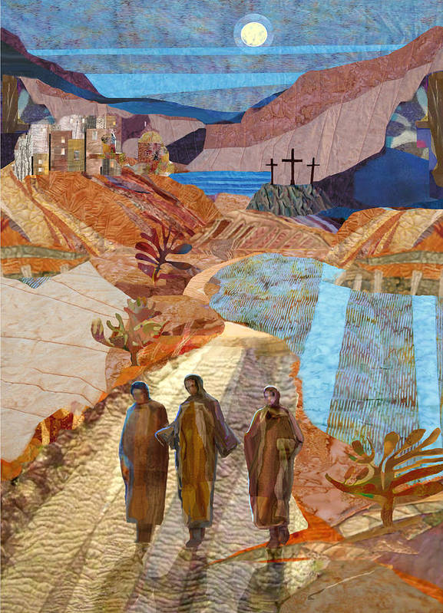

A Vision of a
Year-Round
Process: How to Make It Happen
Tuesday, August 12, 2025 at 1:30pm (English)
Initiation
Workshop

Slide 2


Initiation Workshop SUMMER 2025
Initiation Ministry Partners (Members, Blog Articles, Workshops): https://initiationministrypartners.org/
History of Initiation Ministry Partners (formerly Forum for the RCIA) https://initiationministrypartners.org/about/history-of-the-archdiocesan-forum-for-the-rcia/
Darleine Arce, Chairperson
St Lawrence Catholic Church, Lawrenceville GA

Slide 3

Introductions
Attendees: Please type your Name, Parish, Email,
and Cell Phone # into the “Chat”
Lorraine Miller, BSEd (Univ of Tulsa), CBS (Univ of Dallas), MAPS (Loyola)
Retired Director of Faith Formation at St. Philip Benizi in Jonesboro, GA. She is experienced and passionate about the OCIA process and all levels of faith formation.
Lmiller4961@yahoo.com M: 682-429-3847
Judi Hornback, BSN (DePaul University), MHSA (Governors State University), MAPS (Catholic Theological Union) is the OCIA Director at St Pius X Parish in Conyers, GA. Moving to Georgia 8 years ago from Indiana, she has 35+ years of experience with the OCIA and is passionate about helping newcomers experience the Church.
hornback11@sbcglobal.net M: 219.746.2425

Slide 4
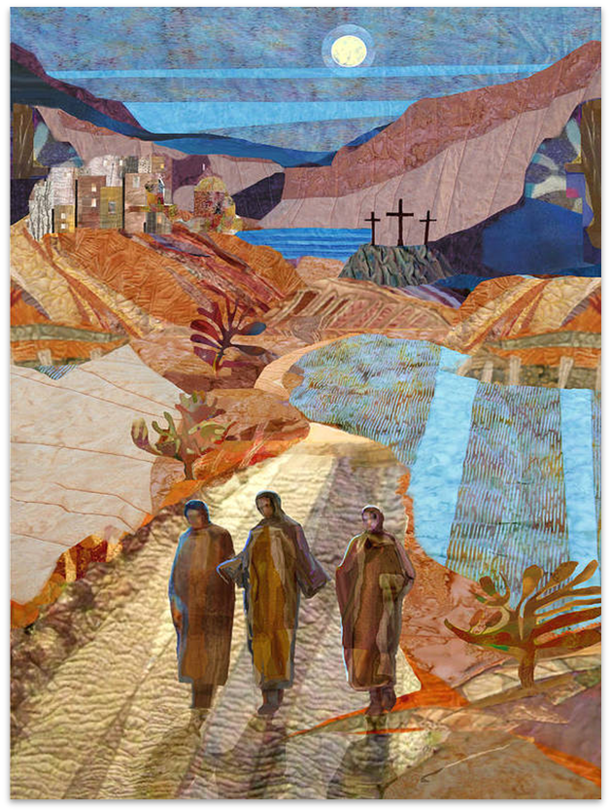
Opening Prayer: An Emmaus Road Blessing
May the RISEN Christ meet you on the road,
Lead you into all truth,
Guide you on your path.
May the RISEN Christ feed and sustain you,
Fill you with his presence,
Equip you with His Spirit.
May the RISEN Christ go with you today,
Be with you through this week, and
May you dwell with Christ forever. Amen.
HOW IN THE WORLD!!: An Emmaus Road Blessing... based on Luke 24:12-31 (howard-carter.blogspot.com)

Slide 5
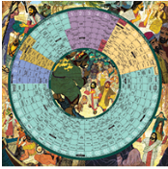

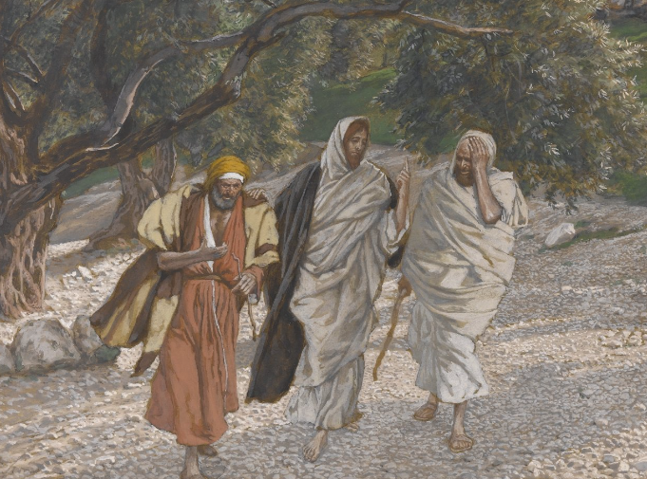
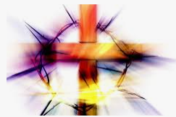
“Year-Round” Process Defined
Ongoing/Continuous
Liturgical Year / Lectionary Cycle
Weekly Sunday Mass Attendance All Year
Accompanying Individuals
Parish Community . . . As the Means
Honoring the Time That It Takes
Notes:
Define what we mean by year- round.

Slide 6
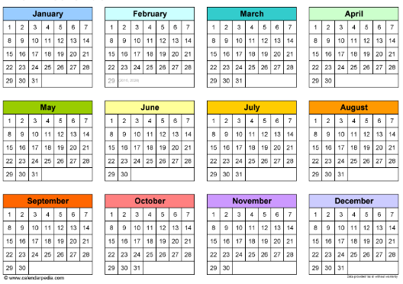
Why “Year-Round” Process Is Important
Called for by the OCIA: #9, #75, #76
Allows anyone to come in at any time
Available when The Spirit prompts
Forming Disciples
  Catechesis = a relationship with Jesus, not merely knowing content
  Primary goal of OCIA = forming committed, gospel living disciples!
OCIA: NOT “One Size Fits All” process, It Takes As Long As It Takes!
Current “School Year (Academic) Model” is NOT sufficient for conversion
or catechesis

Slide 7

The Vision . . . . From Then . . . . .
Vatican II and the “Vision”
1988: Rite of Christian Initiation of Adults (RCIA) mandated
~ 10-15 yrs of CCD/Religious Education/Academic Model and “Flying by the seat of our pants”
CATECHUMENAL Model = a holistic approach
  Liturgically/Lectionary Based
  Relationship with the Lord
  Accompaniment / Community
  Apprenticeship / Missionary Disciples / Activity
  Engagement
  Catechetical Language (NOT Academic Language)
  Meet people where they are
Sponsors
Parish Community
Notes:
FIt the needs to get it going
US Adaptations
Takes 3 years to get to know a person, not just 8-9 months
No specific format in the Rites Book
Disciple on Road to Emmaus were leaving Jerusalem, headed away from the cross. Jesus met them where they were. And asked them to tell him what was going on in their lives.The Spirit moves as he will. Are we ready for him?
Catechesis: Echoing not a “what” but a “who”. Christianity is not an ideology, it is a person.
Year-round allows for people to move not on a formulated schedule or calendar but on their time. It honors the time it takes for conversion to happen and for people to experience Christ in the unfolding of the liturgical year.

Slide 8

The Vision . . . . To Now
Catechumenal Model now used
  Catechesis/Faith Formation
  Synod for Synodality
  Other Sacraments
December 1, 2024: Order of Christian Initiation of Adults (OCIA)
  National Statutes for the Catechumenate: 37→18
  Text Changes
March 5, 2025: OCIA mandatory implementation
Record Keeping
  National Statutes for the Catechumenate #s 14-15-16
    #14 Registry of Catechumens at the Rite of Entrance
    #15 Book of the Elect (Catechumens only)
    #16 Registry of Candidates
Notes:
FIt the needs to get it going
US Adaptations
Takes 3 years to get to know a person, not just 8-9 months
No specific format in the Rites Book
Disciple on Road to Emmaus were leaving Jerusalem, headed away from the cross. Jesus met them where they were. And asked them to tell him what was going on in their lives.The Spirit moves as he will. Are we ready for him?
Catechesis: Echoing not a “what” but a “who”. Christianity is not an ideology, it is a person.
Year-round allows for people to move not on a formulated schedule or calendar but on their time. It honors the time it takes for conversion to happen and for people to experience Christ in the unfolding of the liturgical year.

Slide 9
Language for Year-Round/Continuous
(Catechetical vs Academic)
Convert applies only to a Catechumen, not a Candidate
OCIA process, not a program or a class
Session, not class
Catechist, Facilitator, OR Leader; not teacher or instructor
Group, not students or class
Join or enter, not start or begin
The rest of your life with Christ OR Continuing the journey, not end
Spiritual journey of accompaniment, not series of classes
Apprenticeship, not teaching or training
Building Disciples, OR Catechesis, not teaching

Slide 10








Getting “The Team” on Board
Preparing the Team and Getting Them ‘On Board’
  Sell the Vision of the OCIA: Pastor, Staff, Team, Parish
  OCIA Study Guide / Rites Book
  Attend Workshops Together—In-Person + Online
  Identify Gifts of Team Members
  Listen To and Address Concerns
  Train for Roles and Reponsibilities: Catechists, Sponsors,
Hospitality, Dismissal Leaders, etc.

Slide 11
Start Somewhere . . . . Just Do It!
Take your time!
Start with simple changes
  Move to Lectionary/Liturgical-based Catechesis
  Dismissal
  Combine ‘Breaking Open the Word’ + Catechetical Session
Transition to “Year-Round” in stages
  Add “Inquiry” to be ready whenever new seekers arrive
  Keep “Catechumenate” going through Spring/Summer/Fall
The way these presenters started:
3 Stages . . . . 3 Environments . . . . 3 Teams

Slide 12
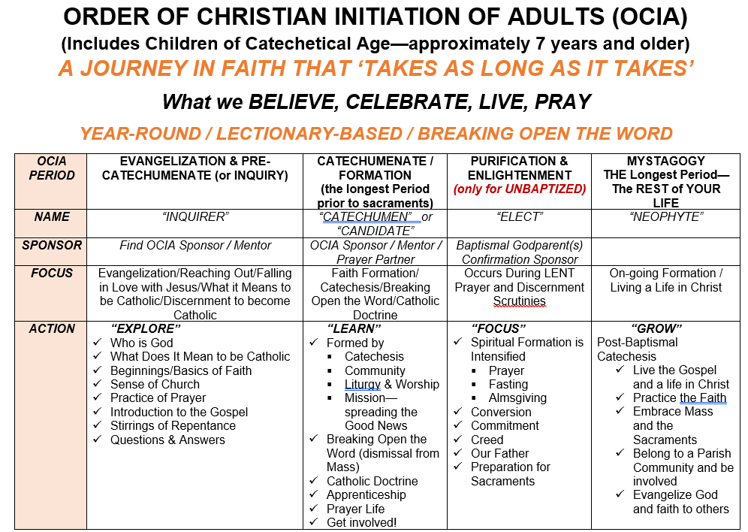
OCIA Periods

Slide 13
Practical Steps: INQUIRY
Initial Conversation/Meeting/Interview is CRITICAL and Determines Path (Baptism, Marriage)
Catechumen vs. Candidate
Flexible Meeting Schedule and comfortable atmosphere.1-2 welcoming people
Sharing Stories–What Brings You Here
Uncovering/Sharing Gifts
Q & A–Encourage This!
Breaking Open the Word
Prayer
Resources: MyParishApp, FlockNotes, Laudate, Hallow, Ascension, CIAY, BIAY, RIAY, The Chosen, FORMED
Topics: Images of God, Liturgical Calendar, The Mass
Sponsors Get Involved–Invite and Accompany
This is the Seeker’s/Inquirer’s Time, Not Ours!
Catechumen → Discernment Process → Rite of Entrance
NOTE: Rite of Welcome for Candidates is optional

Slide 14
Practical Steps: CATECHUMENATE
Meets weekly, Year-Round: Dismissal, Breaking Open the Word, Catechesis/Doctrine
Schedule?
Lectionary-Based, Liturgical Calendar
4-5 Catechists is optimal
Round tables for sharing
Dialogic Presentations & Discussions: Move from ‘formation’ to ‘transformation’
Adults learn best from each other!
“Mystery is . . . . multilayered and pregnant with meaning!” (Richard Rohr)
Why is this truth (e.g., The Resurrection) important? This is MYSTAGOGY at work throughout the entire process!
Catechumens/Candidates move as individuals and not as group
It takes as long as it takes!

Slide 15
Practical Steps: PURIFICATION & ENLIGHTENMENT
PURIFICATION and ENLIGHTENMENT = The Six Weeks of Lent
Journey to Easter Vigil
Prayerful, Spiritual Preparation Prior to Sacraments
  Elect Only
  Elect + Candidates (not Catechumens)
Retreat-like Atmosphere (Prayer table, Chairs in a circle)
Scrutinies/Creed/Lord’s Prayer/Preparation Rites for Elect ONLY
Easter Vigil
  Sacraments of Initiation (Elect Only)
  Combined Rite in US: Sacraments of Initiation + Rite of Reception into Full Communion
  Confirmation “Only” is not part of OCIA, just convenient

Slide 16
Practical Steps: Small or No Team, How YOU CAN Move to Year-Round/Continuous
THE PARISH COMMUNITY is your Catechumenate
Imagine using this model for faith formation at all levels. What would that look like? “They devoted themselves to the teaching of the apostles and to the communal life, to the breaking of the bread and to the prayers.” (Acts 2:42)
  Sponsors!!—Accompaniment
  Parish Events, Liturgies, Activities, Gatherings: Adoration, SVDP, Women’s and Men’s Groups, Breakfast, Fish Fries, Stations of the Cross, Parish Mission, Retreats, Scripture/Bible Studies, Field Trips (Eucharistic Congress, Monastery, Cathedral, other parishes, etc)—Apprenticeship
  Regular Catechetical Sessions only form Part of the Whole Process
  Be BOLD and CREATIVE!
Lectionary-Based REALLY does Connect To Relevant Catholic Doctrine
Resources (see end of presentation)

Slide 17

It’s Messy, BUT . . . It’s Worth It!!
Advantages outweigh Disadvantages
Primary Source of Apprenticeship: The Mass and The Parish Community (Liturgies, Parish Activities, and Events)
Yes, Catechumens/Candidates MAY miss a session (that’s life)
BE FLEXIBLE!!
ADJUST as needed

Slide 18

What are YOUR Fears/Concerns Moving to
Year-Round/Continuous?
Unmute and Ask

Slide 19
Addressing Your Concerns
What About a Schedule?
Not Enough Catechists?
Loss of Group Bonding?
Keeping Track of Who Needs What and When, and Where Are They in the Process?
Having a group of one?
Losing a Summer Break or too many other things in summer?
Losing Your Team?
Taxing Your team?
Others . . . . ?

Slide 20

Team Initiation: Year-Round Articles
Is Your Catechumenate Open all Year-Round? What Does Year-Round Mean?
https://teamrcia.com/2022/09/is-your-catechumenate-open-all-year-round-what-does-year-round-mean/
How to Start a Year-Round RCIA Process
https://teamrcia.com/2021/04/how-to-start-a-year-round-rcia-process/
Learn Why Year-Round is Easier
https://teamrcia.com/2015/07/rcia-learn-why-year-round-is-easier/
Toward a Year-Round RCIA Process–One Thing at a TIme with Small Steps
https://teamrcia.com/2020/11/toward-a-year-round-rcia-process-one-thing-at-a-time-with-small-steps/
A Year-Round Apprenticeship Model for RCIA Gives Me Confidence We Are Forming Disciples
https://teamrcia.com/2020/10/a-year-round-apprenticeship-model-for-rcia-gives-me-confidence-that-we-are-forming-disciples/
Is Your RCIA Open All Year-Round? Being Flexible.
https://teamrcia.com/2020/11/is-your-rcia-open-all-year-round-being-flexible/
We’re Flexible–How Our Parish Does Year-Round RCIA
https://teamrcia.com/2020/09/were-flexible-how-our-parish-does-year-round-rcia/
What Would Happen if Every Parish had an Ongoing (Year-Round) RCIA Process?
https://teamrcia.com/2021/05/what-would-happen-if-every-parish-had-an-ongoing-year-round-rcia-process/

Slide 21
Team Initiation: Year-Round Articles 2
Q&A Multiple Seekers on the Journey of Faith–How to Start a Year-Round RCIA.
https://teamrcia.com/2020/07/qa-multiple-seekers-on-the-journey-faith-how-to-start-a-year-round-rcia/
Jesus’s Timing is Perfect–One Parish’s Experience of Year-Round RCIA.
https://teamrcia.com/2020/08/jesuss-timing-is-perfect-one-parishs-experience-of-year-round-rcia/
Rethinking the Core Catholic Content as We Move to Ongoing Initiation (Year-Round RCIA)
https://teamrcia.com/2020/05/rethinking-the-core-catholic-content-as-we-move-to-ongoing- initiation-
year-round-rcia/
Is Your RCIA Open All Year-Round? Having Everyone Around the Same Table.
https://teamrcia.com/2022/05/is-your-rcia-open-all-year-round-having-everyone-around-the-same-table/
Why is an Ongoing Year-Round RCIA Important?
https://teamrcia.com/2021/04/why-is-an-ongoing-year-round-rcia-important/
RCIA Requires Big Paradigm Shifts, Starting with These Two
https://teamrcia.com/2019/06/rcia-requires-big-paradigm-shifts-starting-with-these-two/
Is Your RCIA Open All Year-Round? Are we Catechizing for Knowledge or Understanding?
https://teamrcia.com/2018/12/is-your-rcia-open-all-year-round-are-we-catechizing-for-knowledge-or-understanding/

Slide 22
Resources for Year-Round / Continuous OCIA
Breaking Open the Word & Sessions
Year-Round Catechumenate by Mary Birmingham. (2007)
ISBN: 978-1568544120
Formed in Faith: Sessions for Inquiry, Catechumenate and Ongoing Faith Formation by Mary Birmingham. (2012) ISBN: 978-1584595908
Breaking Open the Lectionary by Dr Margaret Nutting Ralph, Paulist Press (Cycle A 2007, Cycle B 2005, Cycle C 2006)
Foundations in Faith by Resources for Christian Living (RCL), Allen TX. (1998) Year A (green), Year B (red), and Year C (blue). (no longer printed)
ApprenticesinFaith.com by RCL Benziger (online subscription)
Journey of Faith, Liguori Publications (Adults, Teens, Children; English AND Spanish) + Breaking Open the Word (A, B, C)
Food for the Soul: Reflections on the Mass Readings by Dr Peter Kreeft, Word on Fire [Cycle A (green 2022), Cycle B (blue 2023), Cycle C (maroon 2021)]

Slide 23
Resources for Year-Round / Continuous OCIA
Apprenticeship & Accompaniment
Article: Pros and Cons of a Year-Round RCIA Program
https://www.catechist.com/pros-cons-year-round-rcia-program/
Divine Blessing: Liturgical Formation in the RCIA by Dr Timothy O’Malley, Liturgical Press, Collegeville (2019)
Unfolding the Mystery of Christ: Sunday by Sunday Formation of Catechumens, Eliot Kapitan, Liturgical Press, Collegeville (2020)
Your Roadmap to a Conversion-Centered Catechumenate by John McGlynn, Liturgical Press, Collegeville (2023)
Your Parish is the Curriculum: RCIA in the Midst of Community by Diana Macalintal, Liturgical Press, Collegeville (2018)
Apprenticed to Christ: Activities for Practicing the Catholic Way of Life by Jerry Galipeau. (2007) ISBN: 978-1584593270

Slide 24
Resources for Year-Round / Continuous OCIA
To Help Newcomers
Each Other–SHARE YOU SUCCESSES!
FORMED.ORG
YOUTUBE.COM
FACEBOOK
HALLOW
RECORD KEEPING: Excel Spreadsheet OR Catholic Digital Resources for Ideas
Catholic Digital Resources : Download Catholic faith materials today (catholicdr.com)--not free
**LTP Digital Institute “Implementing the Year-Round Catechumenate”,
Mondays, November 10-17-24, 8p EST, $50.
**FACEBOOK Group: “OCIA Coordinators and Catechists” (an outreach of
LTP)

Slide 25

THOUGHTS? COMMENTS? QUESTIONS?

Slide 26

Initiation Ministry Partners–Next Workshop
Initiation Workshop
FORMING and NURTURING YOUR OCIA TEAM
ENGLISH: Tuesday, October 14, 2025 at 1:30pm EDT
SPANISH: Tuesday, October 21, 2025 at 7:00pm EDT

Slide 27
Closing Prayer
Gracious God, we offer praise and thanks for this time together to share stories and experiences of accompaniment, apprenticeship, and discipleship. Bless us as we leave this gathering, armed with understanding, thoughts, and ideas of the vision and examples of moving to a Year-Round Continuous OCIA Process as we build up Your Kingdom with missionary disciples.
"Show me your ways, LORD, teach me your paths. Guide me in your truth and teach me, for you are God my Savior, and my hope is in you all day long.“ (Psalm 25:4-5)
May the Catechumens and Candidates we serve grow stronger in their faith and shine their light for others.
We pray in the name of the Father, the Son, and the Holy Spirit. Amen.

