Slide 1
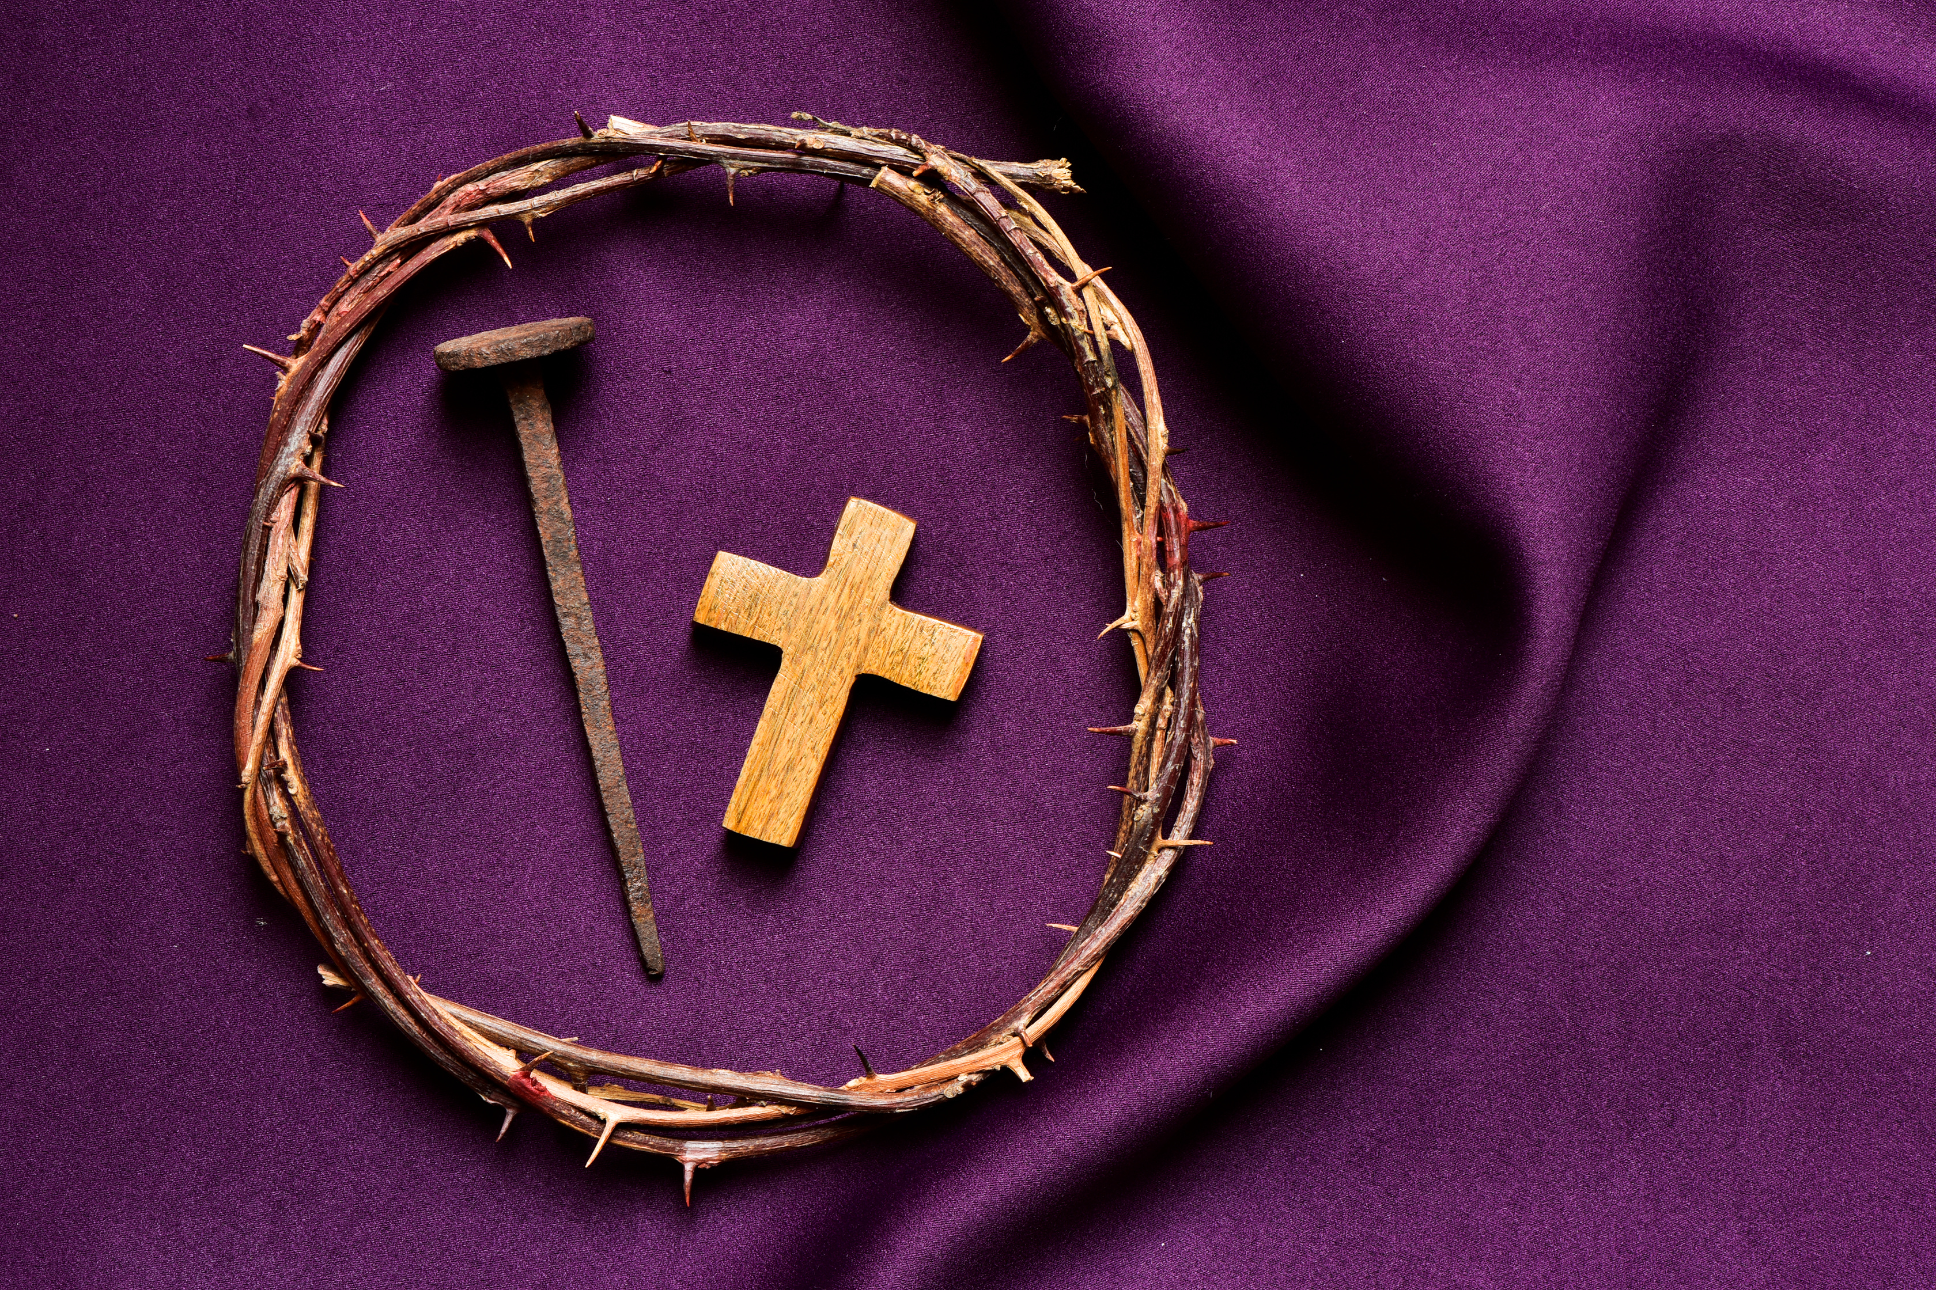

NAVIGATING THE JOURNEY THROUGH THE PERIOD OF PURIFICATION AND ENLIGHTENMENT WITH THE REVISED OCIA
Presented By:
Initiation Ministry Partners
in collaboration with the Office of Evangelization & Discipleship
02.11.2025
rciaatlanta.org

Slide 2

OBJECTIVES OF THE PRESENTATION
This workshop is divided into 3 parts:
Part 1.
An Overview of the Period of Purification and Englightenment
Part 2.
The Rites of the Period of Purification and Englightenment
Part 3.
Navigating the Rites

Slide 3
1.
THE PERIOD OF PURIFICATION AND ENLIGHTENMENT

Slide 4


Slide 5
CHRISTIAN INITIATION PROCESS
The Period of Mystagogy
The Period of Purification & Enlightenment
4
The Period of Evangelization and Precatechumenate
The Period of the Catechumenate
3
2
1
The Period of the Precatechumenate and the Period of the Catechumenate have no fixed beginning or end. Those periods “take as long as it takes.”
However, the Period of Purification and Enlightenment normally coincides with Lent and begins ritually with the Rite of Election. #138 says:
At the end of these periods, the church celebrates the movement of the person from one period to another with what the rite calls “Steps.” These steps, celebrated ritually, do two things: they sum up where the person has been and lead him or her into the next stage of growth and development.

Slide 6
138
In this period, the elect [those Catechumens who have celebrated the Rite of Election with the bishop] together with the local community give themselves to spiritual recollection, so that they may prepare themselves for the Paschal Feasts and for Initiation by the Sacraments.

Slide 7
139
The time of purification and enlightenment is given to a more intense preparation of spirit and heart, which has the character of recollection rather than of catechesis, and is intended to purify hearts and minds by examination of conscience and penitence. This period is intended as well to enlighten their minds and hearts of the elect with a deeper knowledge of Christ the Savior.
In other words, this period has an entirely different “feel” or “atmosphere” than the two preceding periods. The time for “teaching” is over. It’s time for you to serve as a retreat master/a spiritual director or guide.

Slide 8
139
What are some of the things you might do to make it feel different?
  Create a retreat like session. Get rid of the flip chart or white board!
  If your sessions meet at night, dim the lights
  Decorate a prayer table with symbols of the theme of the Sunday readings
  Use music, candles, purple cloths, etc.
  Display a crucifix
  Use meaningful rituals during the sessions (more on that later)
  Give lots of time for reflection and sharing

Slide 9
2.
THE RITES OF THE PERIOD OF PURIFICATION AND ENLIGHTENMENT

Slide 10
138
To this end the Scrutinies, the Rites of Handing On and the Rites of Immediate Preparation are provided for them.
I’m surprised that the new rite stops there, because so much more is provided for them.

Slide 11

THE RITES
The Rite of Sending (Technically this is celebrated before the Period of Purification and Enlightenment begins, but it is necessary to celebrate it before the Rite of Election, so I’m including it here.)
The Rite of Election
The Rite of Calling of the Candidates to Continuing Conversion
The Penitential Rite for Candidates
The First Scrutiny
The Handing On of the Creed
The Second Scrutiny
The Handing On of the Lord’s Prayer
The Rites of Immediate Preparation

Slide 12
THE RITE OF SENDING
Found at #106-110 on p. 77
#106 - When Election takes place with the Bishop, this rite may be celebrated in parishes.
#107 - The preliminary judgment for election regarding the catechumen’s state of formation and progress is made in the parish.This rite offers the local community the opportunity to express its approval of the catechumens and to send them forth to the celebration of Election assured of the parish’s care and support.

Slide 13
THE RITE OF ELECTION
Found at #118-128
#119 – It is called “Election” because the admission made by the Church is founded on election by God, in whose name the church acts.
#120 – Before “Election” is celebrated, the catechumens are questioned regarding their conversion of mind and morals, a sufficient knowledge of Christian doctrine, and their sense of faith and charity; deliberation is especially required regarding their suitability.
These paragraphs are essential reading in order to understand what happens at the Rite of Sending, as well as what happens at the Rite of Election.

Slide 14
THE RITE OF ELECTION
Found at #118-128, continued
#121 - As regards the Church, the “Election” is, as it were, the center of her attentive care for these catechumens…. The Bishop, Priests, Deacons, catechists, godparents, and the entire local community, according to each one’s own order and manner, should render a judgment on the instruction and progress of the catechumens, having considered the matter with the greatest care. Then they embrace the elect with prayer, so that the whole church takes them with her to meet Christ.
#122 - In order to arrive at a wise decision about the suitability of the candidates [catechumens], a discussion must be held before the liturgical celebration by those in charge of the instruction of the catechumens…

Slide 15
THE RITE OF ELECTION
Found at #118-128, continued
·#123 – Then godparents…enroll the catechumen’s name with them.
·#126 - ,,,the Rite of Election should normally take place on the First Sunday of Lent….

Slide 16
THE RITE OF CALLING OF THE CANDIDATES TO CONTINUING CONVERSION
Found at #446-449
#446 – This rite may be celebrated with baptized but uncatechized adults who wish to complete their Christian Initiation through the Sacraments of Confirmation and the Eucharist or who wish to be received into the full communion of the Catholic Church.
#447 – This rite is intended for celebrations in communities where there are no catechumens.

Slide 17
THE RITE OF CALLING OF THE CANDIDATES TO CONTINUING CONVERSION
Found at #446-449, continued
#448 – The rite may be celebrated at the beginning of Lent, especially for adult Catholics.
#446 – There is a combined rite of Election and the Calling of the Candidates for Continuing Conversion found in Appendix I, 3 #547-561).

Slide 18
THE PENITENTIAL RITE (A SCRUTINY FOR CANDIDATES)
Found in Chapter IV: Preparing Adults for Confirmation and the Eucharist Who Were Baptized as Infants and Did Not Receive Catechesis, p. 329, #459-463
#459 – It is held within a Celebration of the Word of God as a kind of Scrutiny, similar to the Scrutinies for the Catechumens.
#461 – Along with the candidates, their sponsors and the larger liturgical assembly also participate in the celebration of the Penitential Rite. Therefore the rite is to be adapted in such a way that it benefits all the participants.This Penitential Rite may also help to prepare the candidates to celebrate the Sacrament of Penance.

Slide 19
THE PENITENTIAL RITE (A SCRUTINY FOR CANDIDATES)
Found in Chapter IV: Preparing Adults for Confirmation and the Eucharist Who Were Baptized as Infants and Did Not Receive Catechesis, p. 329, #459-463
#462 – Gives suggestions for when it might be celebrated.
#463 – Although similar to a Scrutiny, this rite does not contain a prayer of Exorcism.

Slide 20
THE SCRUTINIES
Instructions for all three Scrutinies are found at #141-146, pp. 103-104
#141- The “Scrutinies,” which are celebrated solemnly on Sundays, have the double purpose…to reveal what is weak, sick and sinful in the hearts of the elect so that it can be healed; and what is honorable strong and holy, so that it can be strengthened. The purpose of the Scrutinies, which are brought to completion by the help of Exorcisms, is mainly spiritual.
#142 – The Elect are …expected to progress in genuine self-knowledge through a serious examination of their lives and true penitence.
[More on how to help them with that in Part III.]

Slide 21
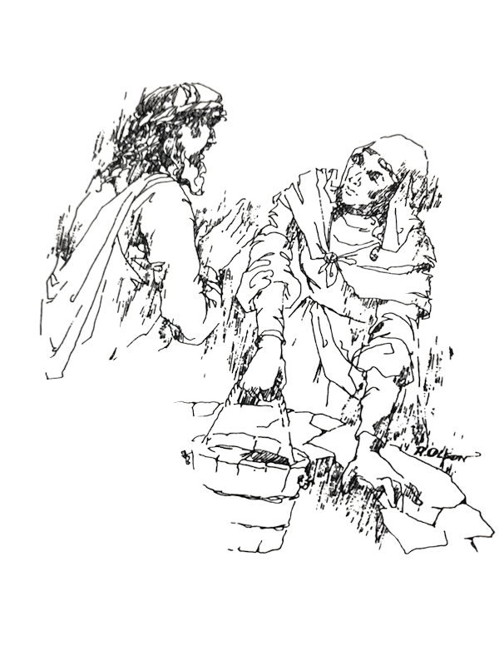
The Cycle A readings must be used on the 3rd, 4th and 5th Sundays of Lent, no matter which cycle we are in, because all three of the Gospels for those Sundays in Cycle A have baptismal themes.
The 1st Scrutiny, based on the story of the Woman at the Well, focuses on Christ the Redeemer who is living water.
The First Scrutiny

Slide 22
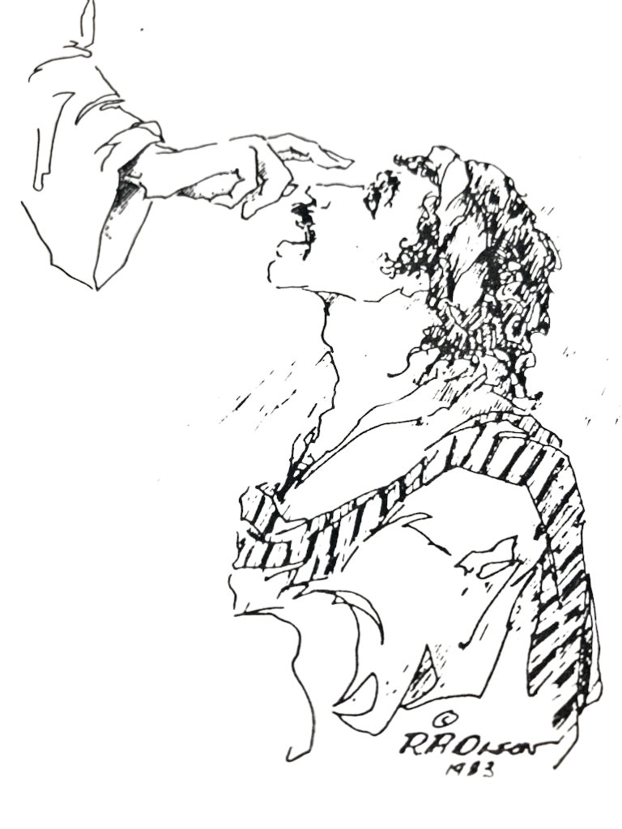
The Second Scrutiny
The 2nd Scrutiny, based on the story of the Man Born Blind, focuses on light.

Slide 23
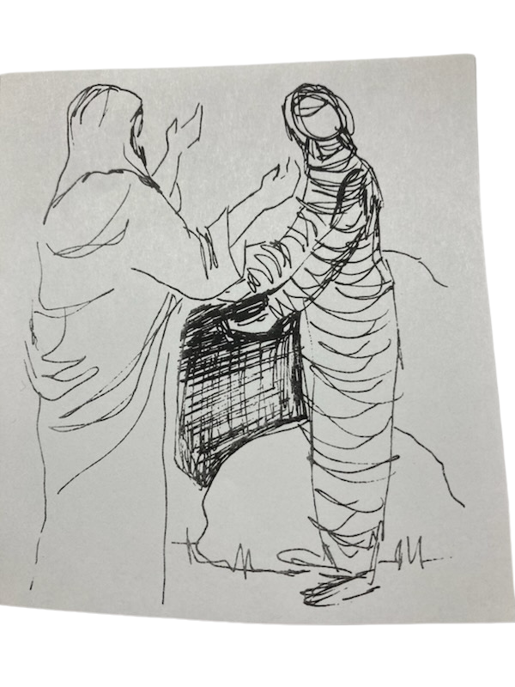
The Third Scrutiny
The 3rd Scrutiny, based on the story of the Raising of Lazarus, focuses on resurrection and life.

Slide 24
THE HANDING ON OF THE CREED
Found at #157, p. 117
Used to be called “The Presentation of the Creed”
#157 – The Rite of Handing On of the Creed takes place during the week following the First Scrutiny. It is desirable that the Rite of Handing On of the Creed takes place in the presence of the community of the faithful after the Liturgy of the Word at a weekday Mass with the appropriate readings for these Rites. If appropriate, it can also be celebrated during the Period of the Catechumenate.

Slide 25
THE HANDING ON OF THE LORD’S PRAYER
Found at #178, p. 145
·#178 – The Handing On of the Lord’s Prayer takes place during the week following the Third Scrutiny. It is desirable that the Rite take place in the presence of the community of the faithful after the Liturgy of the Word at a weekday Mass with the appropriate readings for these Rites. If circumstances suggest, it may also be celebrated during the Period of the Catechumenate (cf. nos. 104-105). If necessary it may be deferred for inclusion in Rites of Immediate Preparation.

Slide 26
THE RITES OF IMMEDIATE PREPARATION
Found at #185-186, p. 149
·A model for this is given at #185-204
  Song
  Greeting
  Reading of the Word
  Homily
  Celebration of the Rites Chosen:
    Recitation of the Creed (by the Elect
    Ephphatha Rite (for the Elect)
    Handing On of the Lord’s Prayer (if not done before)
    Concluding Rites

Slide 27
3.
NAVIGATING THE RITES
(AND MAKING IT ALL WORK!)

Slide 28
SAMPLE TIMELINE
Sunday, March 2: The Rite of Sending & dismissal
Wednesday, March 5: Ash Wednesday (instead of our usual Thursday gathering). We gather in our meeting space and begin with the Liturgy of the Word with the readings for the day. We distribute ashes previously blessed.
Our session that night focuses on the meaning and purpose of the Period of Purification and Enlightenment and the Lenten disciplines of Prayer, Fasting and Almsgiving.
Saturday, March 8: The Rite of Election

Slide 29
SAMPLE TIMELINE, CONT.
Sunday, March 9: 1st Sunday of Lent – The Temptation in the Desert (Cycle C)
The Calling of the Candidates to Continuing Conversion and Dismissal
Thursday, March 13: Mystagogia on the Rite of Election and the Calling of the Candidates to Continuing Conversion
Reflection on the Temptation and the Transfiguration
Sunday, March 16: 2nd Sunday of Lent – The Transfiguration (Cycle C)
Handing On of the Creed and dismissal

Slide 30
SAMPLE TIMELINE, CONT.
Thursday, March 20: Godparent rehearsal for the Scrutinies before our session.
Sponsor rehearsal for the Penitential Rite before our session
Reflection on the Woman at the Well with a water ritual
Sunday, March 23: 3rd Sunday of Lent – The Woman at the Well (Cycle A)
1st Scrutiny for the Elect and dismissal
Thursday, March 27: Reflection on the Man Born Blind with a ritual of light
Preparation for the Sacrament of Reconciliation

Slide 31
SAMPLE TIMELINE, CONT.
Sunday, March 30: 4th Sunday of Lent: The Man Born Blind (Cycle A)
2nd Scrutiny for the Elect and dismissal
Tuesday, April 1: Parish Penance Service with Penitential Rite for Candidates
Thursday, April 3: Reflection on the Raising of Lazarus with ritual of being bound

Slide 32
SAMPLE TIMELINE, CONT.
Sunday, April 6: 5th Sunday of Lent: The Raising of Lazarus
3rd Scrutiny for the Elect and dismissal
Saturday, April 12: Retreat from 9-4 on the Paschal Mystery
Sunday, April 13: Palm Sunday and dismissal
Monday, April 14: Rehearsal for Holy Thursday for all the Elect
Wednesday, April 16: Seder Supper

Slide 33
SAMPLE TIMELINE, CONT.
Thursday, April 17: Triduum - Mass of the Lord’s Supper
Elect have their feet washed
Dismissal
Elect wash the feet of the candidates and team
Reflection on the meaning of this action.
Friday, April 18: The Triduum continues with The Celebration of the Lord’s Passion
Dismissal
Meditation and reflection on the meaning of the Cross
Saturday, April 19: Rehearsal for the Easter Vigil
The Rites of Immediate Preparation
The Easter Vigil

Slide 34



Slide 35
CLOSING PRAYER
A reading from the Gospel of Luke:
They said to each other, “Did not our hearts burn within us while he talked to us on the road, while he opened to us the scriptures?” And they rose that same hour and returned to Jerusalem; and they found the eleven gathered together and those who were with them, who said, “The Lord has risen indeed, and has appeared to Simon!” Then they told what had happened on the road, and how Jesus was known to them in the breaking of the bread.
Good and gracious God, you have entrusted us with forming disciples for the sake of the world. Give us the strength we need to be faithful to our call.
In Jesus’ name we pray. AMEN.
Explain the impact of regulatory challenges
Share case studies and best practices

