Slide 1
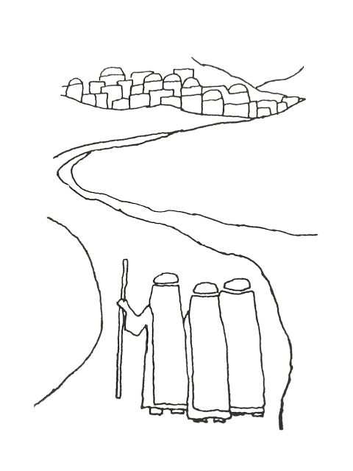
Recruiting, Training and Nurturing Sponsors
Presented by Initiation Ministry Partners
in collaboration with
The Office of Evangelization and Discipleship
November 12, 2024

Slide 2

Part I: Opening Song
1,6. Will you let me be your servant, let me be as Christ to you;
Pray that I may have the grace to let you be my servant, too.
2. We are pilgrims on a journey, we are trav’lers on the road;
We are there to help each other walk the mile and bear the load.
3. I will hold the Christ-light for you in the night-time of your
fear;
I will hold my hand out to you, speak the peace you long to hear.
4. I will weep when you are weeping; when you laugh I’ll laugh with you.
I will share your joy and sorrow ‘til we see this journey through.
5. When we sing to God in heaven we shall find such harmony,
Born of all we’ve known together of Christ’s love and agony.
The Servant Song

Slide 3
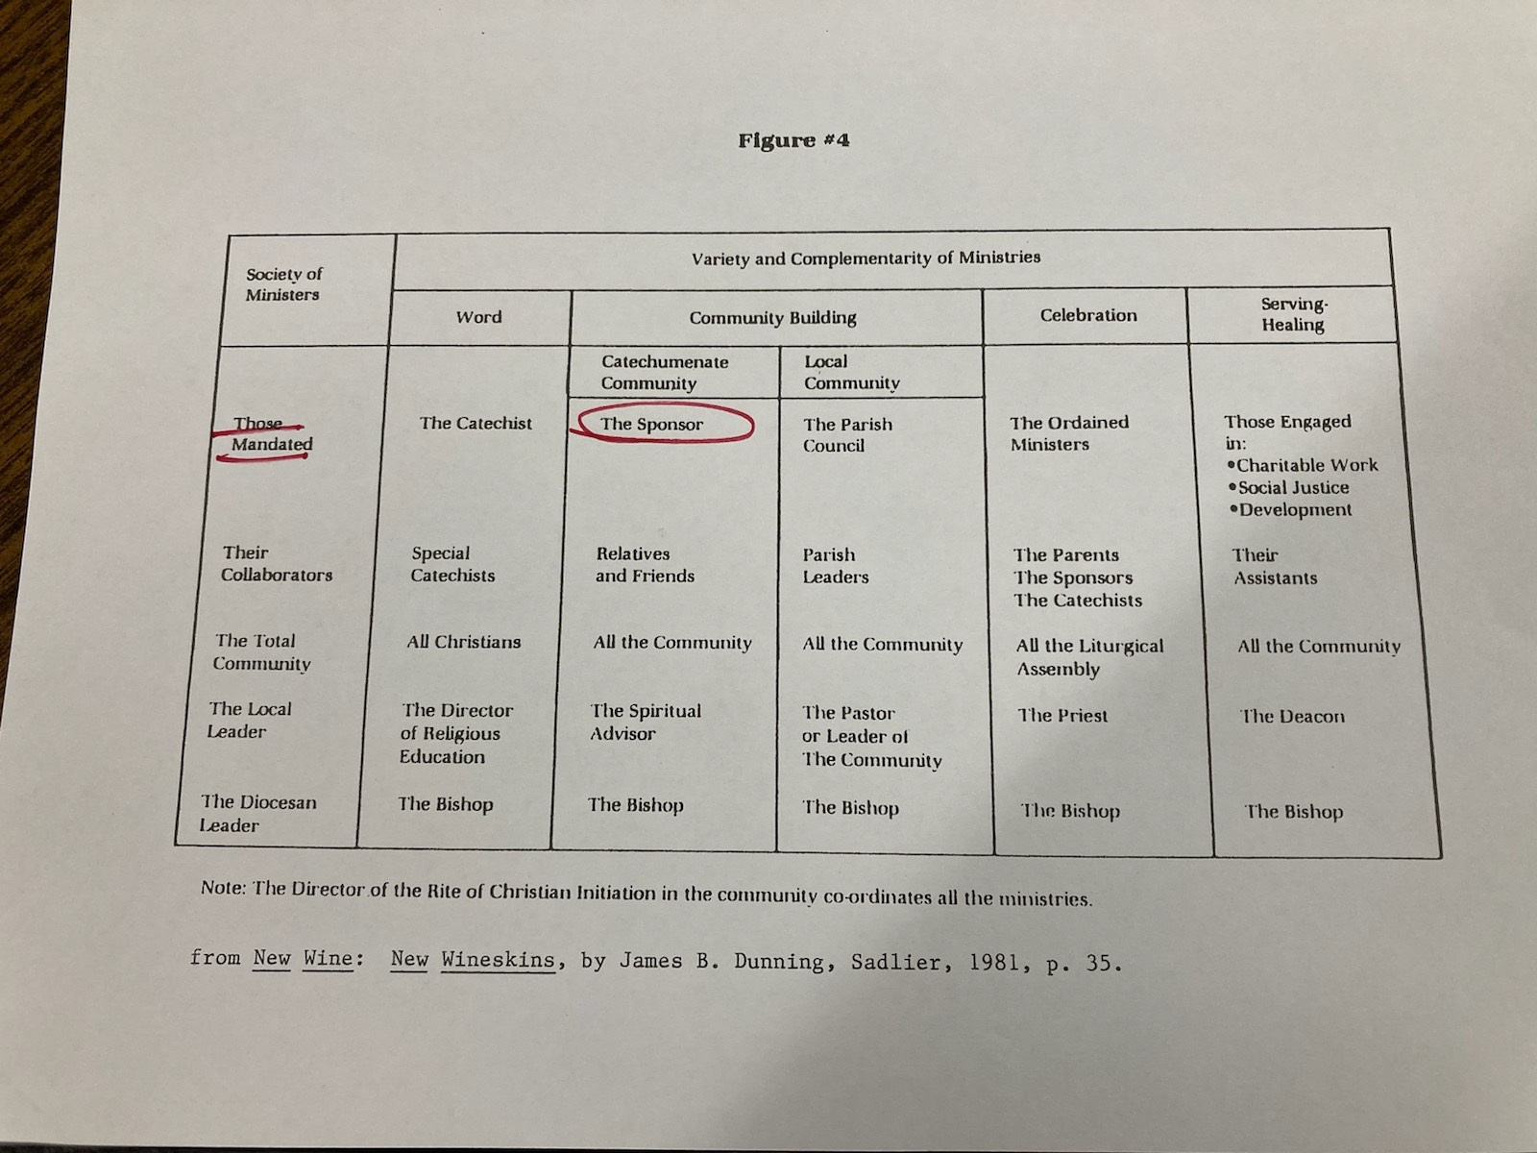
II. a: What the Rite Has to Say about Sponsors

Slide 4
II. b. “Christian Initiation, General Introduction: from The Rite of Christian Initiation of Adults, pp. xiv-xviii
#8 It is a very ancient custom of the Church that adults are not admitted to baptism without godparents,
members of the Christian community who will assist the candidates at least in the final preparation for
baptism and after baptism will help them persevere in the faith and in their lives as Christians.
#9 At least in the later rites of the catechumenate and in the actual celebration of baptism, the part of
godparents is to testify to the faith of adult candidates or…
#10 Therefore, godparents, chosen by the catechumens or by the families of children to be baptized, must, in
the judgment of the parish priest (pastor), be qualified to carry out the proper liturgical functions
mentioned in no. 9.
1. Godparents are persons, other than the parents of candidates, who are designated by the candidates
themselves…Each candidate may have either a godmother or a godfather or both a godmother and a
godfather.
2. Those designated must have the capability and intention of carrying out he responsibility of a godparent
and be mature enough to do so. A person sixteen years of age is presumed to have the requisite
maturity, but the diocesan bishop may have stipulated another age or the parish priest (pastor) or the
minister may decide that there is a legitimate reason for allowing an exception.
3. Those designated as godparents must have received the three sacraments of initiation, baptism,
confirmation, and eucharist, and be living a life consistent with faith and with the responsibility of a
godparent.
4. Those designated as godparents must also be members of the Catholic Church and be canonically free
to carry out this office….

Slide 5
II c. “Ministries and Offices” from the Introduction of the Rite of Christian Initiation of Adults, pp.4-7
#9 In light of what is said in Christian Initiation, General Introduction (no. 7), the people of God, as represented by
the local Church, should understand and show by their concern that the initiation of adults is the responsibility of
all the baptized. Therefore the community must always be fully prepared in the pursuit of its apostolic vocation
to give help to those who are searching for Christ. In the various circumstances of daily life, even as in the
apostolate, all the followers of Christ have the obligation of spreading the faith according to their abilities.
Hence, the entire community must help the candidates and the catechumens throughout the process of initiation:
during the period of the Precatechumenate, the period of the catechumenate, the period of purification and
enlightenment, and the period of postbaptismal catechesis or mystagogy.
[ Then #1-5 elaborate on the responsibilities of the community in each period.]
[Then the ministers are listed in this order:]
#10 A sponsor accompanies any candidate seeking admission as a catechumen. Sponsors are persons who have
known and assisted the candidates and stand as witness to the candidates’ moral character, faith, and intention. …
#11 Their godparents … accompany the candidates on the day of election, at the celebration of the sacraments of
initiation, and during the period of mystagogy. …It is the responsibility of godparents to show the candidates
how to practice the gospel in personal and social life, to sustain the candidates in moments of hesitancy and
anxiety, to bear witness, and to guide the candidates’ progress in the baptismal life….
#12 The bishop
#13 Priests
#14 [more about the priests responsibilities]
#15 Deacons
#16 Catechists

Slide 6
III. What Does It Mean to Be a Sponsor?
Sponsors give witness/
testimony to the Catechumens and Candidates and to the community
Sponsors are companions/
fellow travelers on this journey of faith
Sponsors are friends, mentors, and guides
Sponsors represent the Catholic Community

Slide 7
IV. Traits of a Sponsor
actively listens to the Catechumen or Candidate
listens to his/her own life
prays
willing to share his/her own faith journey
serves as a bridge to the community
respectful
respects the Catechumen’s or Candidates freedom
meets the Catechumen or Candidate where they are
does not have all the answers

Slide 8
Attend the sessions
Be present at all the rites
Attend the Sponsor Training and Sponsor Meetings
Meet outside of the sessions with his/her Catechumen or Candidate for coffee, lunch, dinner, etc.
Introduce the Catechumen or Candidate to the parish and its activities
V. What Should a Sponsor Be Expected to Do?

Slide 9
Keep the Team informed about the concerns of the Catechumen or Candidate
Keep the Team informed about the Sponsor’s own concerns
Remember that they are there for the sake of the Catechumen or Candidate—not primarily for themselves
Continue the relationship for at least a year
Note: If you expect a lot of your Sponsors, you get a lot!
(Continued)

Slide 10





A renewal or deepening of a faith relationship with God
VII. What Can a Sponsor Expect for Him/herself?
A strong sense of community and belonging
A better sense of identity in terms of self and church
A new friend

Slide 11
Part II: Sponsor Recruiting, Formation and Nurturing
The Role of the Sponsor Coordinator
Ongoing Communication
Recruiting
Matching
Training
Supporting

Slide 12

II. Sponsor Training
Sign in (Coffee and doughnuts
Sponsors fill out application form)
Welcome/Thank you for saying “yes”
Introductions:
family
where from?
how long at parish and your involvement
why do you want to be a Sponsor?

Slide 13
Sponsor Training
(Continued)
Presentation
  What is RCIA (OCIA)?
  A History of the Catechumenate
  Clarify words/terms
  Steps and stages of the RCIA (OCIA) journey
  Read Luke 24:13-35 – The Road to Emmaus
  Ask them to find the parallels to the RCIA (OCIA) journey
  If necessary, go over the annulment process

Slide 14
Sponsor Training
(Continued)
Video: “Becoming an RCIA Sponsor”
  Part I – Inquiry
    Discussion
  Part II – Catechumenate
    Discussion
  Part III – Before Purification and Enlightenment
    Discussion
  Part IV – Fr. Jim Dunning

Slide 15



In the sessions, when questions are asked, sit out the silence – wait for them to speak
Sponsor Training
(Continued)
Know that the team is here for you as well as for the Catechumens and Candidates
Some Helpful Hints for Sponsors
The parking lot after the sessions is where good things happen!

Slide 16
Sponsor Training
(Continued)
Materials
- I provide them with lots of handouts
- Guide for Sponsors by Ron Lewinski, Liturgy Training Publications

Slide 17
III. Sponsors Meet the Inquirers
I use an exercise from Stephen Ministry called “A Relationship Exercise”.
Sponsors sit face to face with the Inquirer and each take turns completing the following sentences:
  My name is…
  I come from…
  I work at…(or I go to school at…)
  My family is made up of…
  The best thing I did during the past year was…
  Some of my nicknames are…
  I feel happy when…
  What I do for fun is…
  The greatest person I have ever met is…and then give some reasons
  I’m afraid of…
  What I dislike doing is…
  Something I regret is…
  I feel sad when…
  I feel uneasy or embarrassed when…
  Something I like about you is…
  I am in the RCIA process because…(Sponsors answer this one, too.)

Slide 18
Entrance procession
IV. Sponsor Commissioning
Opening Song: “Here I Am, Lord”, Dan Schutte
Opening Prayer
Liturgy of the Word
    Jeremiah 1: 4-9
    Ps. 139 – “You Are Near”, Dan Schutte
    Gospel acclamation
    John 1:1-9
    Reflection
    Reflection song: “Be Not Afraid”, Bob Dufford, SJ
Format for a Liturgy held in the church

Slide 19
Acceptance of the Ministry of Sponsor
Sponsor Commissioning
(Continued)
Lighting of the Sponsors’ Candles
The Blessing of the Sponsors
Sponsors recite the Sponsor’s Prayer
Sponsors welcome the Inquirers
Sponsors present the Word of God to the Inquirers (making the sign of the cross on their forehead, lips, and heart) and give them their lit candle.
Closing Prayer
Closing Song: “The Summons”, John L. Bell

Slide 20

V. Sponsor Meetings
A meeting to check in after they have been a sponsor for about 2 months.
A meeting before Lent to prepare them for additional responsibilities.
A meeting during Mystagogia to prepare them to help with discernment of where God is calling the new Catholics
Rehearsals for Rites
General principle: keep them a few steps ahead of the seekers!

Slide 21
VI. Closing Prayer

