Slide 1
New Horizons
in Initiation Ministry
Upcoming Changes to Catechumenal Ministry
Rebranding of Name
Website Support Tools

Slide 2
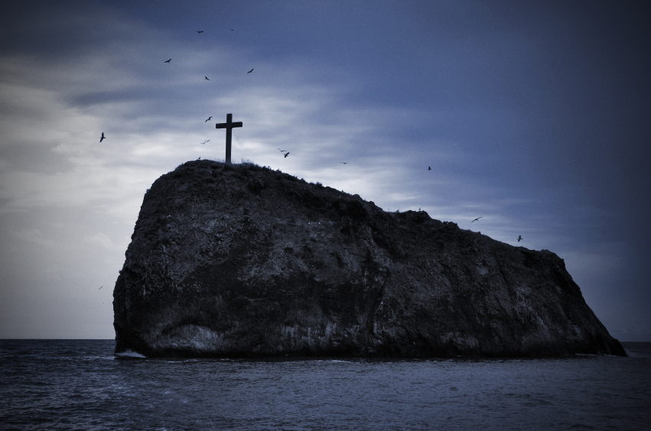
Opening Prayer
God, grant us the serenity to accept the things we cannot change, courage to change the things we can, and wisdom to know the difference.
Heavenly Father, in walking with seekers through the initiation process, may we have peace in knowing that You are always with us. Your love, grace, and mercy are unending. Help us to trust in Your steadfastness and to find comfort in Your presence.
Strengthen our faith and those we accompany, reminding us that You are always guiding and protecting us. May we always seek Your will and find our confidence in You.
Amen.
From everlasting to everlasting, thou art God.
—Psalm 90:2

Slide 3
The New Translation
Resources
https://teaminitiation.com/presents/ocia-resourcerding/OFPDCXLO?hash=4DAs/ (Team Initiation)
https://my.demio.com/recoSH20nBDyD (FDLC)
https://fdlc.org/2021/11/ocia-whats-new-whats-not-whats-next/ (Older FDLC presentation, but it provides some of the changes at a glance.

Slide 4
What has changed
The Title: No longer (RCIA) Rite, But (OCIA) Order
Personal change: Consider not using either acronym.
What other way can you refer to the process of initiation in your parish for seekers, team members, and community?

Slide 5
COMPARING VOCABULARY 1988 vs. 2024 editions FDLC
Current Term English New Term English
Rite of Christian Initiation of Adults Order of Christian Initiation of Adults
Rite of Acceptance into the Order of Catechumens Rite for Entrance into the Catechumenate
Signing of the Senses Signing of the Forehead and of the Senses
Dismissal of the Catechumens and the Elect Dismissal of the Catechumens
Sending of the Catechumens for Election Rite of Sending Catechumens for Election
Adapted from Handout prepared by the Federation of Diocesan Liturgical Commissions
Source: BCDW Secretariat, June 2024

Slide 6
Current Term English
Clearer terms (Candidate, Candidate for Baptism, Candidate for Full Communion)
Part II (Special Circumstances), Par. numbers.
Presentation of the Creed
Presentation of the Lord’s Prayer
Preparation Rites on Holy Saturday
New Term English
Inquirer, Catechumen, Candidate
Part II (Special Circumstances) Chapter nos. 2-6
Handing on of the Creed
Handing on of the Lord’s Prayer
Rites of Immediate Preparation.
Notes:
“Handing on” from the latin “traditio”.

Slide 7
What Hasn’t Changed: The Church’s Vision for Initiation
Quote:
“This is an opportunity to take a closer look at what we’ve been doing, what we should be doing, what the church calls us to do. And we can’t miss this opportunity.” Todd Williamson (FDLC)

Slide 8
To Ponder: Reaching the Church’s Vision for Initiation
Outline of the process remains the same. Same Steps (Rites) and Periods. What are some best practices for each of the steps of initiation?
Arrangement of text has not changed. Paragraph numbers remain the same. Have I (we) read, studied, pondered the texts to uncover and understand the church’s vision? Is there one change I (we) can make to come closer to the vision? Is my pastor and team onboard and familiar with the vision of the text?
Appendices have remained. Combined Rites, Acclamations, Hymns, Songs, National Statutes (Revised)
The Revised edition incorporates music from other Ritual Texts.
Notes:
The Revised edition incorporates music from other Ritual Texts (Roman Missal, Order of Confirmation, Order of Blessing of the Oils, and Chrism) to assist presiders during the celebration of the rites so that they aren’t trying to juggle two ritual texts (ideally, they will be able to put down the Roman Missal, turn to the OCIA ritual text, use it, and then return to the Roman Missal at the appropriate time all while being able to participate in the appropriate hymns and acclamations).

Slide 9
To Ponder: Continued
Paragraph 9: Role of the community as primary. How can I make better use of the community to form our seekers?
Paragraph 75: Suited to the Liturgical year. Are we immersing people in the life of Christ that unfolds naturally throughout the liturgical year?
Paragraph 76: A process, not a program. It takes as long as it takes for conversion to happen. Years, if necessary. Are we still beginning our process at a set time and ending at a set time? Are we welcoming seekers into the process when they come to us?
The new translation is an opportunity to embrace the vision of the Initiation Process more fully. What one change would you make if you weren't afraid of change or failure?

Slide 10
Rebranding: Why a Name Change?
Notes:
The Revised Order of Christian Initiation which we are preparing for, is meant to transform our parishes, its goal is to infuse all aspects of church life, leading people to the heart of encounter, and leading us to a renewal of missionary disciples. The Archdiocesan Forum for the RCIA was born in 1985, but in some respects, its ministry in initiation goes further back before such a concept even existed. Nonetheless, after 60 years, and in light of other auxiliary changes, the logo and name are changing.

Slide 11
New Name: Initiation Ministry Partners
Notes:
Henceforth, the group has chosen to embrace the name of Initiation Ministry Partners, as we seek to walk with directors, coordinators, and teams who are in the ministry of Welcoming and leading others to Christian Conversion and/or full Initiation.
Explanation of Simple Logo:
We are all on the journey together. Every parish is different; our struggles are different, and yet out goal is the same, to lead all those who come to us to a fruitful encounter with the one, true God, the Son. Our logo, we hope, depicts that individual journey. For some, there may be more obstacles than for others, but we journey together near the stream of life giving water, nourished

Slide 12
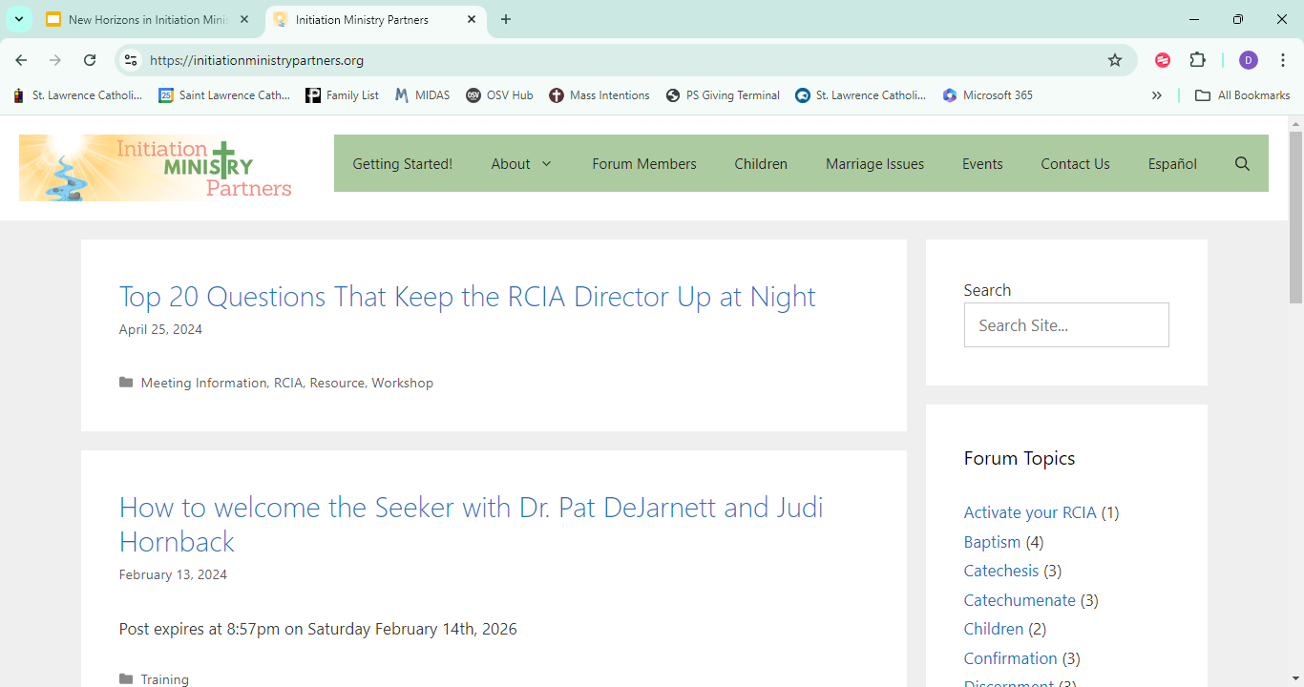
initiationministrypartners.org
Notes:
This is the new landing page of Initiation Ministry Partners website. (The right hand side features an expanded list of the various topics of blogs that have been written on RCIA topics that can be helpful to you!), The most recent presentations will always be posted at the top so that they’re easily accessible if you were not able to attend the virtual workshop.
We will not go through all of the tabs, so I encourage you to make note of the URL at the top of this screen and visit the website when you have some time and save it to your favorites.

Slide 13
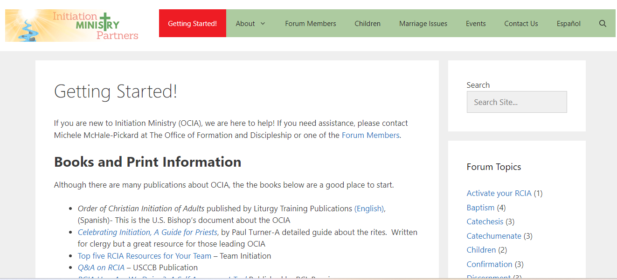
Notes:
The Getting started tab is a great place for new directors or those who are looking for updated information on books, websites, and other handy resources at a quick glance. There are other tabs at the top you may want to check out, including but not limited to children & marriage issues. Let’s pause briefly here to discuss those.

Slide 14
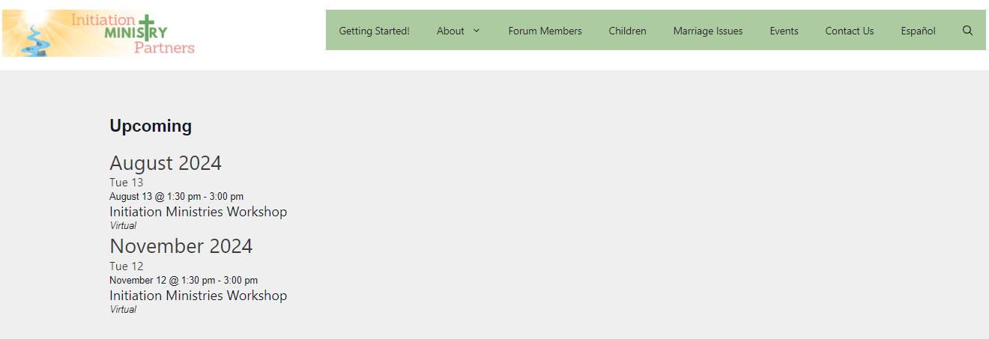
Events
Notes:
The Events tab allows you to see and join upcoming initiation ministry workshops. As a note, OED is planning on bringing in national speakers in early 2025 to review the changes to the National Statutes and new translation of the OCIA Ritual Text. The desire is to reach as many OCIA directors and teams as possible in an in-person event. A poll was sent out to gauge the best meeting times (the deadline to respond is this Friday, August 16th ).

Slide 15
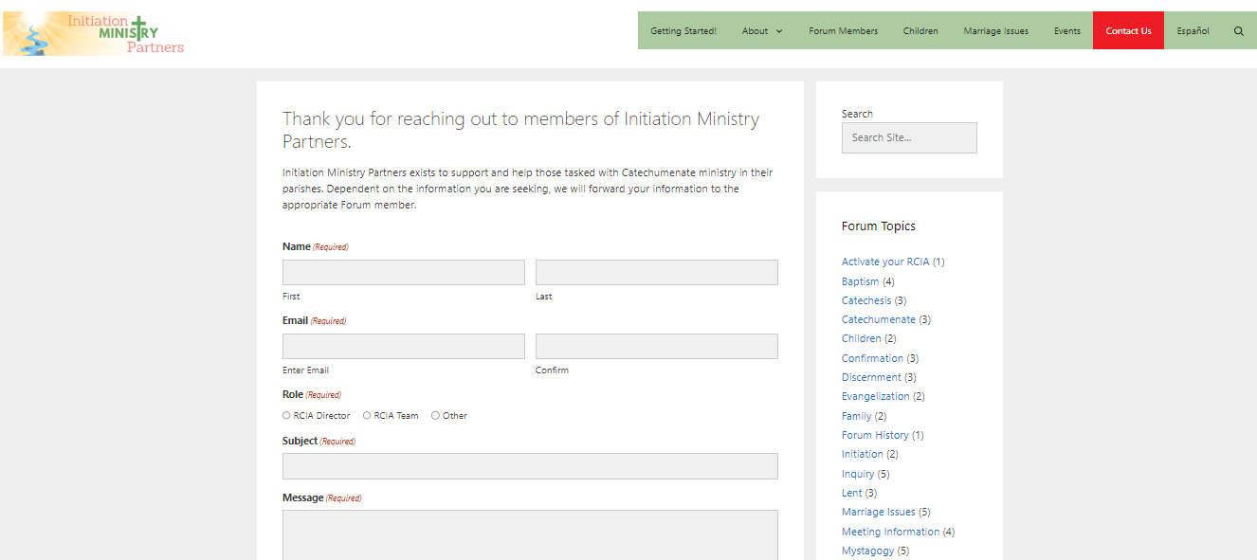
Contact us
Notes:
Lastly, the contact us tab is extremely helpful. Few directors know that we do so much more than host these virtual workshops. Our team is open to helping with talks, putting on an in person workshop for a training day, helping with team training, mentoring for RCIA/OCIA Directors/Coordinators, answer questions, and provide best practices.
The best way for us to serve you is for you to reach out, and the easiest way to reach out is to either use the contact form on this page, OR email atlantainitiationministies@gmail.com.

Slide 16
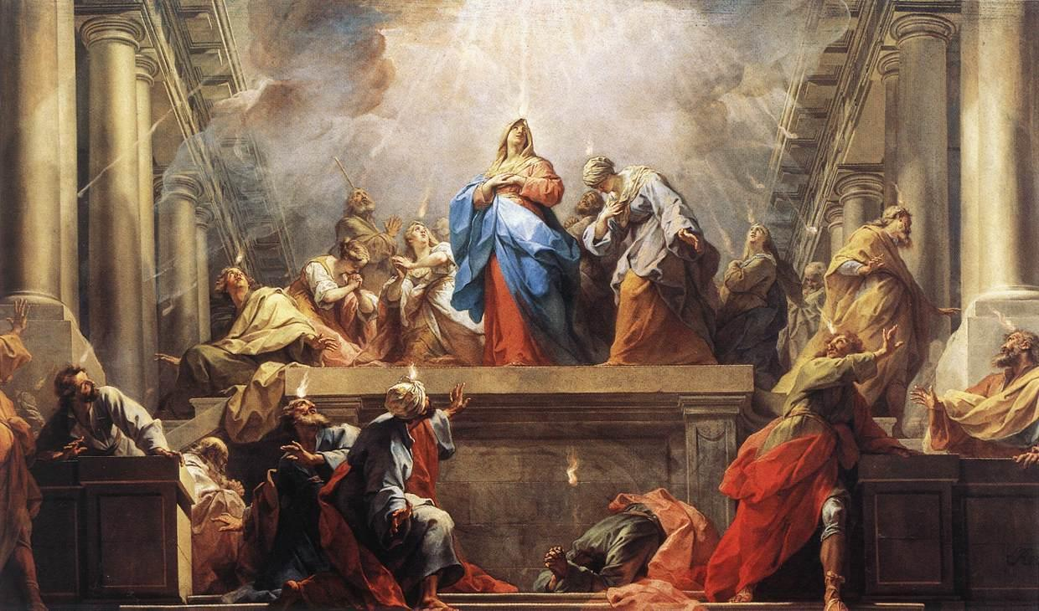
Closing Prayer
Come, Holy Spirit, fill the hearts of your faithful. And kindle in them the fire of your love. Send forth your Spirit and they shall be created. And you will renew the face of the earth.
Lord, by the light of the Holy Spirit you have taught the hearts of your faithful. In the same Spirit help us to relish what is right and always rejoice in your consolation. We ask this through Christ our Lord. Amen.
The English translation of the Prayer to the Holy Spirit from A Book of Prayers © 1982, International Committee on English in the Liturgy, Inc.

