Slide 1


WINTER 2024 INITIATION WORKSHOP
“How Do We Welcome the Seeker?”
Tuesday, February 13, 2024, at 1pm (English)
Tuesday, February 20, 2024, at 6:30pm (Spanish)
Notes:
Track 4 Page 117

Slide 2

WINTER 2024 INITIATION WORKSHOP
DARLEINE ARCE HERNANDEZ
CHAIRPERSON
Archdiocesan Forum for the RCIA (Members, Blog Articles, Workshops): https://rciaatlanta.org/
Notes:
Track 4 Page 117

Slide 3
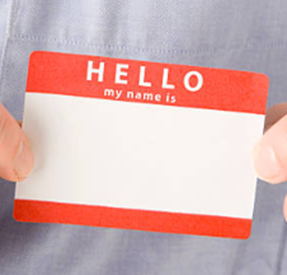
INTRODUCTIONS
Attendees: Please type your Name, Parish, Email, and Cell Phone # into the “Chat”
Patricia DeJarnett, B.S. (Eastern Kentucky), M.S. & Ph. D (University of Toledo), MS (Southern Poly), and The Liturgical Institute, Summer 2007, directed the Archdiocese of Atlanta Office for Divine Worship 2007-2022. She facilitated the RCIA Rite of Election, the RCIA Call to Continuing Conversion, and the Liturgical portion of the Annual Eucharistic Congress. Pat is a member of the Archdiocesan Forum for the RCIA.
psdej@att.net M: 404.281.5099
Judi Hornback, BSN (DePaul University), MHSA (Governors State University), MAPS (Catholic Theological Union) is the RCIA Director at St Pius X Parish in Conyers GA. She has 35+ years of experience with the RCIA in three dioceses (IL, IN, GA) and has a passion for helping newcomers experience the Church.
hornback11@sbcglobal.net M: 219.746.2425
Charles Jones is the RCIA liaison to the Archdiocesan Forum for the RCIA in the Archdiocese of Atlanta Office for Evangelization and Discipleship.
cjones1@archatl.com
Notes:
Track 4 Page 117

Slide 4
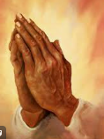
INITIATION WORKSHOP
How Do We Welcome the Seeker?
OPENING PRAYER
Heavenly Father, we come together knowing that You call each of us by name and patiently wait for our response. Help us, as clergy, directors, catechists, sponsors, and faith community to respond to the call of the Holy Spirit and accompany those who seek You and Your Truth. We pray for open minds and loving hearts to serve You and those who seek You through this Church. We pray for the guidance and grace needed to pastorally welcome and minister to those whom You have called. Lead us to build a Catholic community of believers and to keep expanding it, sharing Your love and our faith. We pray this through Christ, our Lord. Amen.
Notes:
Track 4 Page 117

Slide 5

INITIATION WORKSHOP
How Do We Welcome the Seeker?
WORKSHOP GOALS
  To understand the difference between “Inviting” and “Welcoming” the Seeker
  To identify what the Seeker is “seeking” / “wants” / “is pursuing”
  To identify the Seeker’s sacramental status
  To guide the Seeker onto the “right path” to becoming Catholic
  To address the Seeker’s questions
  To introduce the Seeker to the Catholic Church
  To be inclusive and welcome those with special needs
Notes:
Track 4 Page 117

Slide 6

INITIATION WORKSHOP
How Do We Welcome the Seeker?
INVITATION
  External
    Website
    Facebook Page / Social Media
    Sign and/or Banner
    Church Bulletin
    Personal Invitation
  Internal
    Promotional Material (Brochure)
    Ministries
    Ministry Fair or Showcase
    Announcement / Invitation at Mass
    Personal Invitation
Notes:
Track 4 Page 117

Slide 7



INITIATION WORKSHOP
How Do We Welcome the Seeker?
RESPONSE
  From Seeker
    Phone Call or Email to Parish
    Voicemail left
    In the hallway
  Back to Seeker
    Service Standard
    Timely
    Specific / Accurate Information
Notes:
Track 4 Page 117

Slide 8
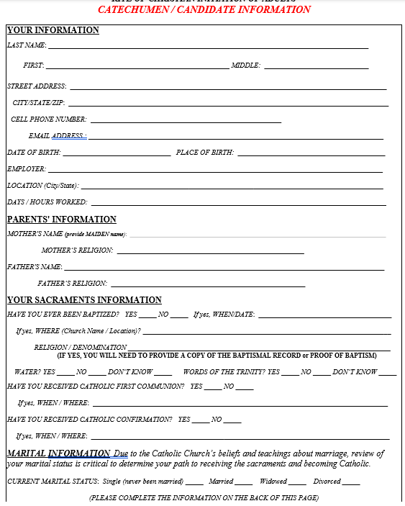
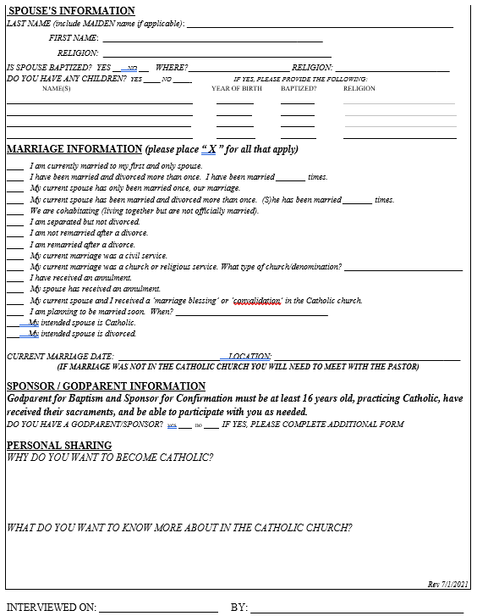
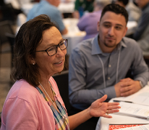

INITIATION WORKSHOP
How Do We Welcome the Seeker?
INITIATION MINISTRY . . . .
GATHERING INFORMATION
  What
  Why
  How
  And Now What . . . .
Notes:
Track 4 Page 117

Slide 9
INITIATION WORKSHOP
How Do We Welcome the Seeker?
Notes:
Track 4 Page 117

Slide 10
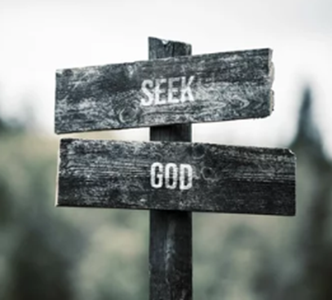


INITIATION WORKSHOP
How Do We Welcome the Seeker?
DETERMINE THE PATHWAY
INDIVIDUALIZED!
  Unbaptized = Catechumen
  Validly Baptized = Candidate
  Confirmation Only
  Evaluate Level of Catechesis and Needs
“Special Needs” Accommodations
  Physical
  Developmental
Notes:
Track 4 Page 117

Slide 11


INITIATION WORKSHOP
How Do We Welcome the Seeker?
  SETTING EXPECTATIONS
  Develop lifelong discipleship
  Liturgical Cycle/Lectionary
  Not just the Sacraments
  Holy Spirit is in charge!
  It takes as long as it takes!
  Reception of Sacraments
    Catechumen: Easter Vigil
    Candidate: When Ready
Notes:
Track 4 Page 117

Slide 12
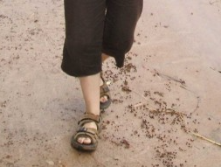
INITIATION WORKSHOP
How Do We Welcome the Seeker?
PRE-CATECHUMENATE
Focus: Exploring
Addressing THE SEEKER’S questions!
What it means to be Catholic
Introduction to the Mass
Sponsor (Accompaniment)
Provide resources
Notes:
Track 4 Page 117

Slide 13


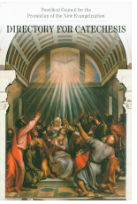
INITIATION WORKSHOP
How Do We Welcome the Seeker?
RESOURCES
Liturgy and the Law: https://www.vatican.va/archive/cod-iuris-canonici/cic_index_en.html
RCIA Rites Book
National Statutes on the Catechumenate: https://lacatholics.org/wp-content/uploads/2021/07/The-National-Statutes-of-the-Catechumenate.pdf
National Directory for Catechesis, 2020: https://www.ncclcatholic.org/directory-for-catechesis.html
Notes:
10-01s

Slide 14




INITIATION WORKSHOP
How Do We Welcome the Seeker?
RESOURCES
TeamRCIA: https://teamrcia.com/
LTP (Liturgy Training Publications) https://ltp.org/products/subject/BKSCIN/christian-initiation
  Catechumeneon: https://catechumeneon.org/
FDLC (Federation of Diocesan Liturgical Commissions): https://fdlc.org/
The Archdiocesan Forum for the RCIA: https://rciaatlanta.org/
Notes:
10-01s

Slide 15

INITIATION WORKSHOP
How Do We Welcome the Seeker?
CLOSING / SUMMARY
      Inviting—right tools
      Welcoming—right people
      Accommodating—right resources
      Accompaniment—right path
Notes:
10-01s

Slide 16

INITIATION WORKSHOP
How Do We Welcome the Seeker?
QUESTIONS
Notes:
10-03a

Slide 17
INITIATION WORKSHOP
COMING SOON . . . . .
SPRING 2024 INITIATION WORKSHOP
“What Keeps an RCIA Director Up at Night? Q&A”
Tuesday, May 14, 2024 at 1pm (English)
Tuesday, May 21, 2024 at 6:30pm (Spanish)
Notes:
10-03a

Slide 18

INITIATION WORKSHOP
How Do We Welcome the Seeker?
CLOSING PRAYER
God of all, we Thank You for your greatness and praise You for your goodness. We are grateful for calling us to this ministry. May our sharing today inspire us, Lord, to grow in our ministry as directors, catechists, sponsors, and lay faithful. In our roles, may we serve the whole family of believers and bring them closer to you. We pray through Christ, Our Lord. Amen.
Notes:
Track 4 Page 117

