Slide 1
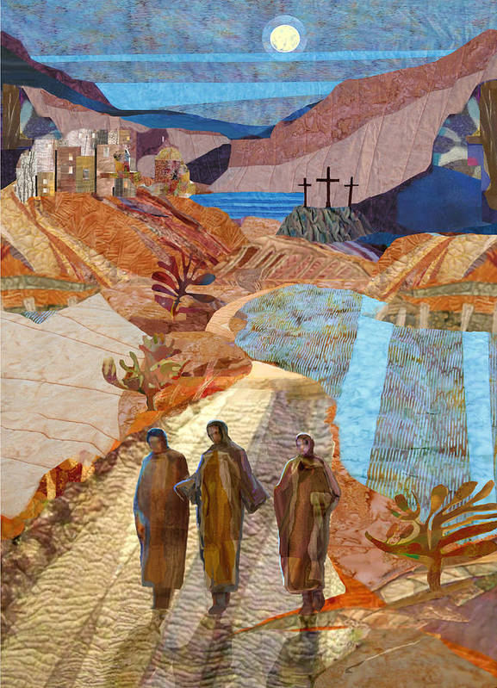
Moving to a Year-Round
Catechumenate:
Why It’s Important
AND
How To Get There
Tuesday, November 7, 2023 at 1pm (English)
Tuesday, November 14, 2023 at 6:30pm (Spanish)
Initiation
Workshop

Slide 2
Initiation Workshop FALL 2023
Archdiocesan Forum for the RCIA (Members, Blog Articles, Workshops): https://rciaatlanta.org/
History of the Forum
https://rciaatlanta.org/about/history-of-the-archdiocesan-forum-for-the-rcia/
Terry Zobel, Chairperson
St Thomas Aquinas, Alpharetta GA

Slide 3
Introductions
Attendees: Please type your Name, Parish, Email,
and Cell Phone # into the “Chat”
Lorraine Miller, B.S.Ed, CBS, Univ of Dallas, M.P.S., Loyola Retired Director of Faith Formation at St. Philip Benizi in Jonesboro, GA. She is experienced and passionate about the RCIA process and all levels of faith formation.
Lmiller4961@yahoo.com M: 682-429-3847
Judi Hornback, BSN (DePaul University), MHSA (Governors State University), MAPS (Catholic Theological Union) is the RCIA Director at St Pius X Parish in Conyers GA. Moving to Georgia 6 years ago from Indiana, she has 35 years of experience with the RCIA and loves helping newcomers experience the Church.
hornback11@sbcglobal.net M: 219.746.2425

Slide 4
Opening Prayer: An Emmaus Road Blessing
May the RISEN Christ meet you on the road,
Lead you into all truth,
Guide you on your path.
May the RISEN Christ feed and sustain you,
Fill you with his presence,
Equip you with His Spirit.
May the RISEN Christ go with you today,
Be with you through this week, and
May you dwell with Christ forever. Amen.
HOW IN THE WORLD!!: An Emmaus Road Blessing... based on Luke 24:12-31 (howard-carter.blogspot.com)

Slide 5
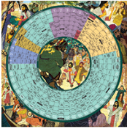
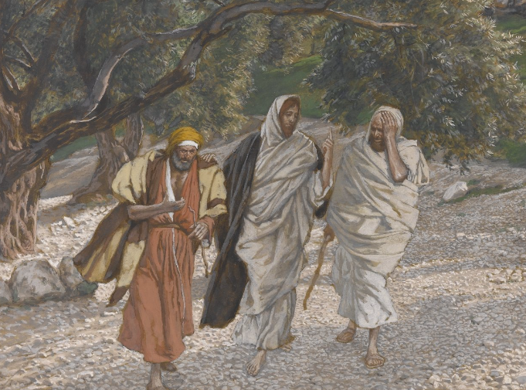
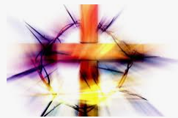
“Year-Round” Catechumenate Defined
Continuous Liturgical/Lectionary Cycle
Paschal Mystery
Resurrected Jesus and “Little Easters”
This life is but seconds compared to
all eternity (1Cor 15:19)
The Road to Emmaus . . . .
Notes:
Define what we mean by year- round.

Slide 6
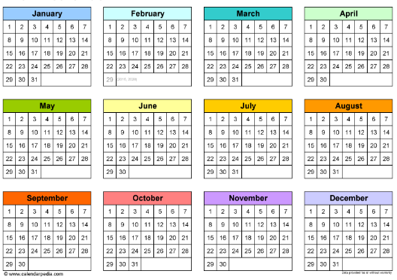
Why “Year-Round” Catechumenate Is Important
Called for by the RCIA: #9, #75, #76
Allows anyone to come in at any time
Available when The Spirit prompts
Forming Disciples
Catechesis = a relationship with Jesus, not merely knowing content
Primary goal of RCIA = forming committed, gospel living disciples!
RCIA is NOT a “One Size Fits All” process, and It Takes As Long As It Takes!
Current “School Year (Academic) Model” is NOT sufficient for conversion or catechesis

Slide 7
How We Got Here . . . . Historical Perspective
Vatican II and the “Vision”
1988–Rite of Christian Initiation of Adults, Study Guide mandated
~ 14 yrs of CCD/Religious Education/Academic Model and “Flying by the seat of our pants”
“School Year” Model not conducive for falling in love with Jesus/building relationship
Catechumenal Model
Liturgically/Lectionary Based
Accompaniment
Apprenticeship
Catechetical Language (NOT Academic Language) is vital
Meet people where they are
Used now for Catechesis/Faith Formation, Synod, and other Sacraments
The importance of Sponsors and the Parish Community
Notes:
FIt the needs to get it going
US Adaptations
Takes 3 years to get to know a person, not just 8-9 months
No specific format in the Rites Book
Disciple on Road to Emmaus were leaving Jerusalem, headed away from the cross. Jesus met them where they were. And asked them to tell him what was going on in their lives.The Spirit moves as he will. Are we ready for him?
Catechesis: Echoing not a “what” but a “who”. Christianity is not an ideology, it is a person.
Year-round allows for people to move not on a formulated schedule or calendar but on their time. It honors the time it takes for conversion to happen and for people to experience Christ in the unfolding of the liturgical year.

Slide 8
Getting “The Team” on Board
Preparing the Team and Getting Them ‘On Board’
Sell the Vision of the RCIA (Pastor, Staff, Parish, Team)
RCIA Study Guide / Rites Book
Attend workshops together (In-Person + Online)
Identify gifts of team members
Listen to and address concerns
Train for roles and responsibilities (Catechists, Sponsors,
Hospitality, Dismissal Leaders, etc)

Slide 9
Language for Year-Round/Continuous
(Catechetical vs Academic)
RCIA process, not a program or a class
Session, not class
Catechist, Facilitator, or Leader; not teacher or instructor
Group, not students or class
Join or enter, not start or begin
The rest of your life with Christ OR Continuing the journey, not end
Spiritual journey of accompaniment, not series of classes
Apprenticeship, not teaching or training

Slide 10
Start Somewhere . . . . Just Do It!
Take your time!
Start with simple changes
Move to Lectionary/Liturgical-based catechesis
Dismissal
Combine ‘Breaking Open the Word’ & Catechetical Session
Transition to “Year-Round” in stages
Add “Inquiry” to be ready whenever new seekers arrive
Keep “Catechumenate” going through Spring/Summer/Fall
The way these presenters started:
3 Stages . . . . 3 Environments . . . . 3 Teams

Slide 11
RCIA Periods

Slide 12
Practical Steps: INQUIRY
INQUIRY
Initial Conversation/Meeting/Interview is CRITICAL and Determines Path (Baptism, Marriage)
Flexible Meeting Schedule and comfortable atmosphere.1-2 welcoming people
Sharing Stories–What Brings You Here
Uncovering/Sharing Gifts
Q & A–Encourage This!
Breaking Open the Word
Prayer
Resources: MyParishApp, Laudate, Hallow
Topics: Images of God, Liturgical Calendar, The Mass
Sponsors Get Involved–Invite and Accompany
This is the Seeker’s/Inquirer’s Time, Not Ours!
Catechumen/Candidate moves to catechumenate after Discernment Process and Rite of Acceptance (or Rite of Welcome–optional)

Slide 13
Practical Steps: CATECHUMENATE
CATECHUMENATE
Meets weekly, Year-Round: Dismissal, Breaking Open the Word, Catechesis/Doctrine
Lectionary-Based, Liturgical Calendar
4-5 Catechists is optimal
Round tables for sharing
Dialogic Presentations & Discussions: Move from ‘formation’ to ‘transformation’
Adults learn best from each other!
“Mystery is . . . . multilayered and pregnant with meaning!” (Richard Rohr)
Why is this truth (e.g., The Resurrection) important? This is MYSTAGOGY at work throughout the entire process!
Catechumens/Candidates move as individuals and not as group
It takes as long as it takes!

Slide 14
Practical Steps: PURIFICATION & ENLIGHTENMENT
PURIFICATION and ENLIGHTENMENT = The Six Weeks of Lent
Journey to Easter Vigil
Prayerful, Spiritual Preparation Prior to Sacraments
Elect Only
Elect + Candidates (not Catechumens)
Retreat-like Atmosphere (Prayer table, Chairs in a circle)
Scrutinies/Creed/Lord’s Prayer/Preparation Rites for Elect ONLY
Easter Vigil
Sacraments of Initiation (Elect Only)
Combined Rite in US: Sacraments of Initiation + Rite of Reception into Full Communion

Slide 15
Practical Steps: Small or No Team, How YOU CAN Move to Year-Round/Continuous
THE PARISH COMMUNITY is your Catechumenate
Imagine using this model for faith formation at all levels. What would that look like? “They devoted themselves to the teaching of the apostles and to the communal life, to the breaking of the bread and to the prayers.” (Acts 2:42)
Sponsors!! (Accompaniment)
Parish events and gatherings: Adoration, SVDP, Women’s and Men’s Groups, Breakfast, Fish Fries, Stations of the Cross, Parish Mission, Retreats, Scripture/Bible Studies, Field Trips (Eucharistic Congress, Monastery, Cathedral, other parishes, etc)
Regular catechetical sessions only form a part of the whole process
Be BOLD and CREATIVE!
Lectionary-Based REALLY does Connect To Relevant Catholic Doctrine
Resources (see end of presentation)

Slide 16
It’s Messy, BUT . . . It’s Worth It!!
Advantages outweigh Disadvantages
Primary Source of Apprenticeship: The Mass and The Parish Community (Liturgies, Parish Activities and Events)
Yes, Catechumens/Candidates MAY miss a session (that’s life)
BE FLEXIBLE!!
ADJUST as needed

Slide 17
What are YOUR Fears/Concerns Moving to
Year-Round/Continuous?
Type your Questions in the “CHAT”!

Slide 18
Addressing Your Concerns
Not Enough Catechists?
Loss of Group Bonding?
Keeping Track of Who Needs What and When, and Where Are They in the Process?
Having a group of one?
Losing a Summer Break or too many other things in summer?
Losing Your Team?
Taxing Your team?
Others . . . . ?

Slide 19
TeamRCIA: Year-Round Articles
Is Your Catechumenate Open all Year-Round? What Does Year-Round Mean?
https://teamrcia.com/2022/09/is-your-catechumenate-open-all-year-round-what-does-year-round-mean/
How to Start a Year-Round RCIA Process
https://teamrcia.com/2021/04/how-to-start-a-year-round-rcia-process/
Learn Why Year-Round is Easier
https://teamrcia.com/2015/07/rcia-learn-why-year-round-is-easier/
Toward a Year-Round RCIA Process–One Thing at a TIme with Small Steps
https://teamrcia.com/2020/11/toward-a-year-round-rcia-process-one-thing-at-a-time-with-small-steps/
A Year-Round Apprenticeship Model for RCIA Gives Me Confidence We Are Forming Disciples
https://teamrcia.com/2020/10/a-year-round-apprenticeship-model-for-rcia-gives-me-confidence-that-we-are-forming-disciples/
Is Your RCIA Open All Year-Round? Being Flexible.
https://teamrcia.com/2020/11/is-your-rcia-open-all-year-round-being-flexible/
We’re Flexible–How Our Parish Does Year-Round RCIA
https://teamrcia.com/2020/09/were-flexible-how-our-parish-does-year-round-rcia/
What Would Happen if Every Parish had an Ongoing (Year-Round) RCIA Process?
https://teamrcia.com/2021/05/what-would-happen-if-every-parish-had-an-ongoing-year-round-rcia-process/
Q&A Multiple Seekers on the Journey of Faith–How to Start a Year-Round RCIA.
https://teamrcia.com/2020/07/qa-multiple-seekers-on-the-journey-faith-how-to-start-a-year-round-rcia/
Jesus’s Timing is Perfect–One Parish’s Experience of Year-Round RCIA.
https://teamrcia.com/2020/08/jesuss-timing-is-perfect-one-parishs-experience-of-year-round-rcia/
Rethinking the Core Catholic Content as We Move to Ongoing Initiation (Year-Round RCIA)
https://teamrcia.com/2020/05/rethinking-the-core-catholic-content-as-we-move-to-ongoing-initiation-year-round-rcia/
Is Your RCIA Open All Year-Round? Having Everyone Around the Same Table.
https://teamrcia.com/2022/05/is-your-rcia-open-all-year-round-having-everyone-around-the-same-table/
Why is an Ongoing Year-Round RCIA Important?
https://teamrcia.com/2021/04/why-is-an-ongoing-year-round-rcia-important/
RCIA Requires Big Paradigm Shifts, Starting with These Two
https://teamrcia.com/2019/06/rcia-requires-big-paradigm-shifts-starting-with-these-two/
Is Your RCIA Open All Year-Round? Are we Catechizing for Knowledge or Understanding?
https://teamrcia.com/2018/12/is-your-rcia-open-all-year-round-are-we-catechizing-for-knowledge-or-understanding/
Seek the Living God by Nick Wagner (book)

Slide 20
Resources for Year-Round / Continuous RCIA
Year-Round Catechumenate by Mary Birmingham. (2007)
ISBN: 978-1568544120
Formed in Faith: Sessions for Inquiry, Catechumenate and Ongoing Faith Formation by Mary Birmingham. (2012) ISBN: 978-1584595908
Apprenticed to Christ: Activities for Practicing the Catholic Way of Life by Jerry Galipeau. (2007) ISBN: 978-1584593270
Foundations in Faith by Resources for Christian Living (RCL), Allen TX. (1998)
Year A (green), Year B (red), and Year C (blue).
ApprenticesinFaith.com by RCL Benziger (online subscription)
Journey of Faith, Liguori Publications (Adults, Teens, Children; English AND Spanish)
Food for the Soul: Reflections on the Mass Readings (Three-Volume Set) by Dr. Peter Kreeft
Your Parish is the Curriculum by Diana Macalintal, TeamRCIA
LTP–Liturgy Training Publications
Breaking Open the Lectionary by Margaret Nutting Ralph
Article: Pros and Cons of a Year-Round RCIA Program
https://www.catechist.com/pros-cons-year-round-rcia-program/
Articles & Webinars from Team RCIA: “The Parish is the Catechetical Plan”
Each Other–Share Your Successes!
RECORD KEEPING: Excel Spreadsheet OR Catholic Digital Resources for Ideas
Catholic Digital Resources : Download Catholic faith materials today (catholicdr.com)--not free
FORMED.ORG
YOUTUBE.COM

Slide 21
THOUGHTS? COMMENTS? QUESTIONS?

Slide 22
Forum for the RCIA–Next Initiation Workshop
Initiation Workshop
How Do We Welcome the Seeker?
ENGLISH: Tuesday, February 13, 2024 at 1:00pm EST
SPANISH: Tuesday, February 20, 2024 at 6:30pm EST

Slide 23
Closing Prayer
Dear Lord of all, we praise You, honor You, and thank You.
Bless us as we leave this gathering, armed with understanding, thoughts, and ideas to move to a Year-Round Continuous Catechumenate as we build up Your Kingdom with missionary disciples.
"Show me your ways, LORD, teach me your paths. Guide me in your truth and teach me, for you are God my Savior, and my hope is in you all day long.“ (Psalm 25:4-5)
May the catechumens and candidates we serve grow stronger in their faith and shine their light for others.
We pray in the name of the Father, the Son, and the Holy Spirit. Amen.

