Slide 1
Creating An Effective Mystagogy

Slide 2
Mystagogy – Greek
mystes (initiated) and agein (to conduct or lead)
Mystagogia means to be led into the mysteries. Another interpretation of the word mystagogia means that those on this journey become students of the mysteries.

Slide 3
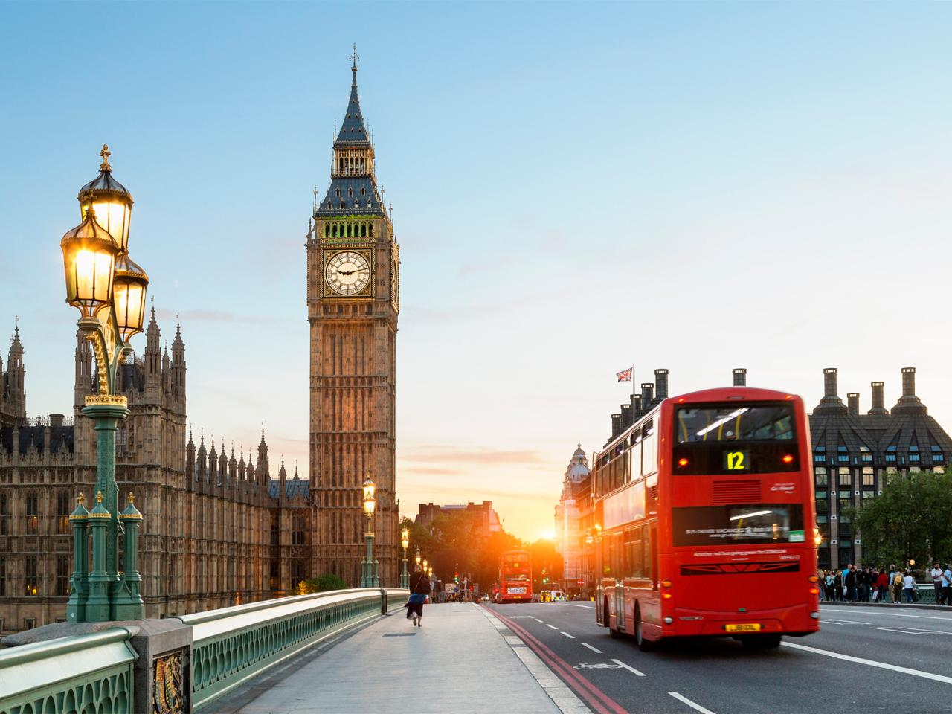
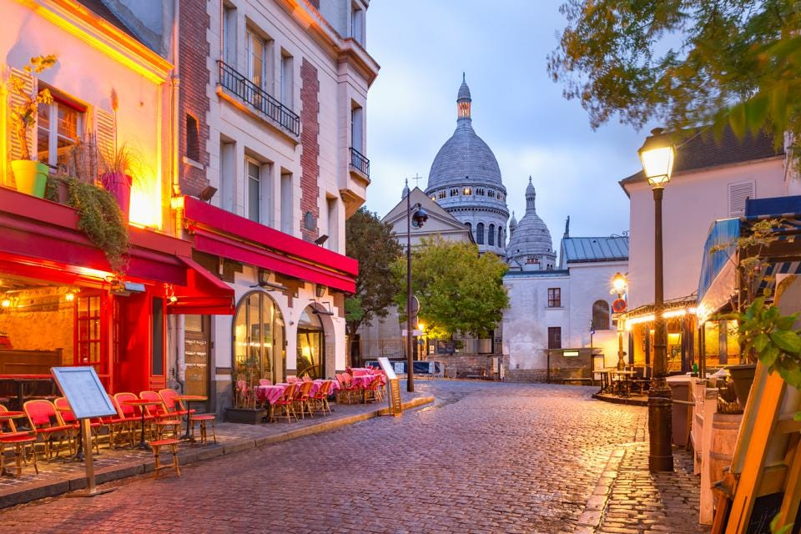
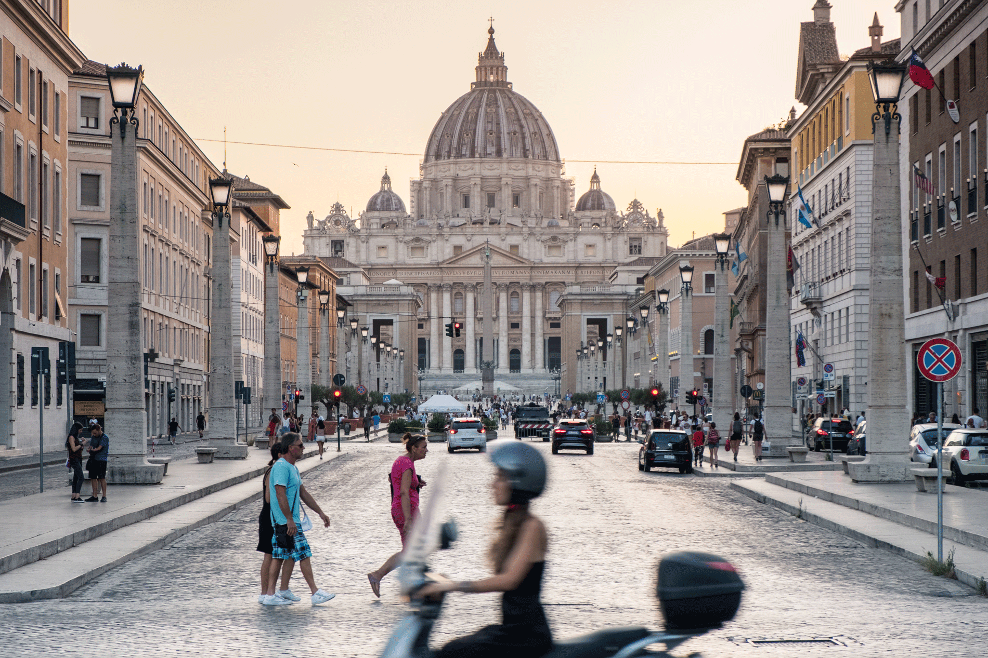

Slide 4
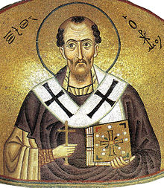
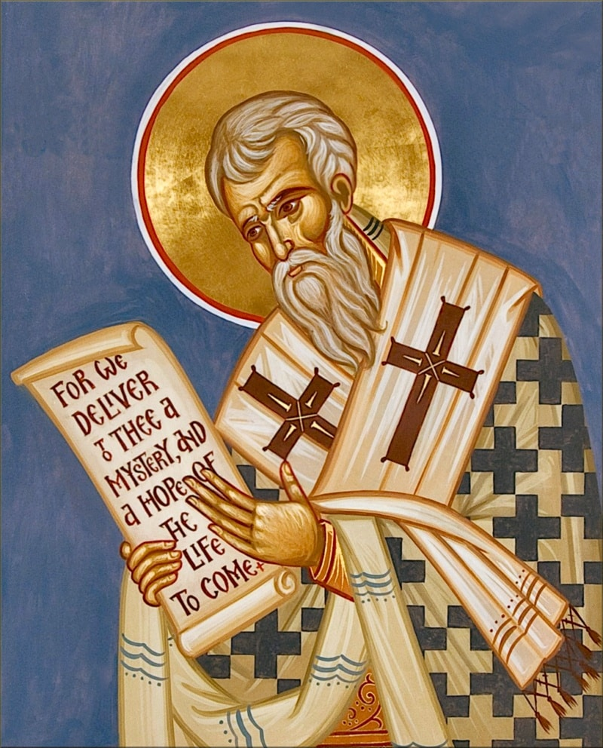
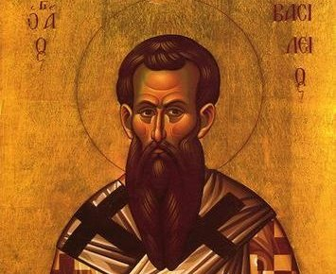
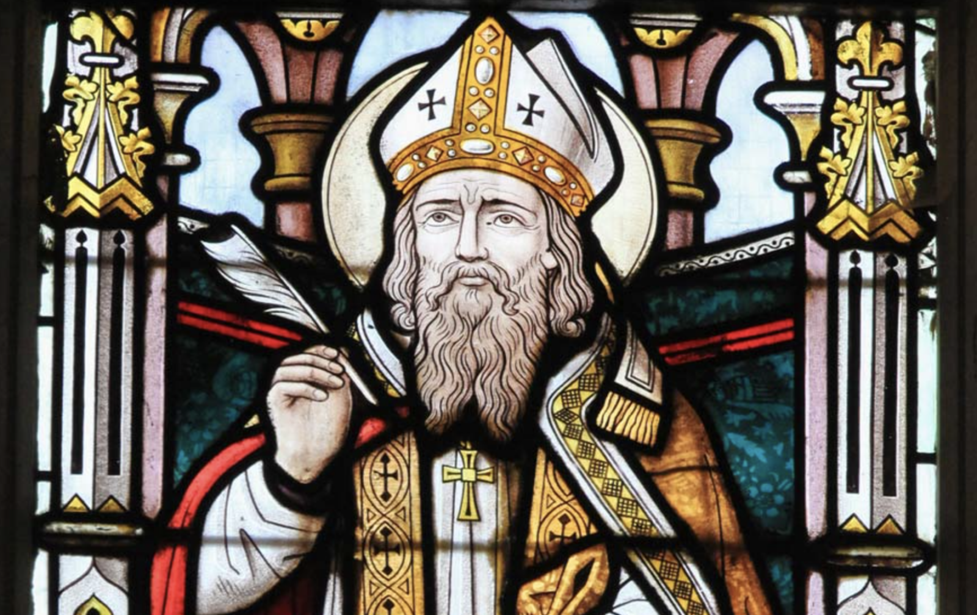
St. John Chrysostom
347-407
Theodore of Mopsuestia
350-428
Cyril of Jerusalem
313-386
Ambrose of Milan
339-397

Slide 5
On Anointing of the Catechumens before Baptism
“Next after removing your garments you were rubbed with exorcised oil from the hair of your head to your toes, and so you became sharers in Jesus Christ, who is the cultivated olive tree.”
Cyril of Jerusalem
On baptism: “In one and the same action you died and were born; the water of salvation became both tomb and mother for you.”
Cyril of Jerusalem

Slide 6
On the kiss of peace
“Next the deacon says in a loud voice: Receive one another, and let us kiss one another. Do not assume that this is the customary kiss exchanged by friends in public. No, this kiss joins souls together in search of complete forgiveness from one another. So the kiss is a mark of fusion of souls, and of expulsion of all resentment for wrongs. It is for this reason that Christ said: ‘ if you are offering your gifts at the altar, and there remember that your brother has something against you, leave there your offering on the altar, and go first and be reconciled to your brother, and then come near and offer your gift. ‘So the kiss is a reconciliation, and therefore holy. This is what I think St. Paul meant when he said, ‘Greet one another with a holy kiss’, and St. Peter when he says, ‘Greet one another with the kiss of love.’ Cyril of Jerusalem

Slide 7
On the institution narrative of the Eucharistic Prayer
‘How can something which is bread be the body of Christ? Well, by what words is the consecration effected, and whose words are they? The words of the Lord Jesus . . . All that is said before are the words of the priest: praise is offered to God, the prayer is offered up, petitions are made . . . but when the moment comes for bringing the most holy sacrament into being, the priest does not use his own words any longer: he uses the words of Christ. Therefore, it is Christ’s word that brings this sacrament into being. Ambrose of Milan

Slide 8
Sense of Awe
A teaching quality/formative
Past tense
Connections to Scripture/Tradition
Catechesis as a method to ongoing conversion/living the faith

Slide 9
OBSTACLES TO MYSTAGOGY
Our vision of mystagogy is too small – we see it as the fourth and final act of the RCIA.
It begins long before that as Terry is about to tell us.

Slide 10
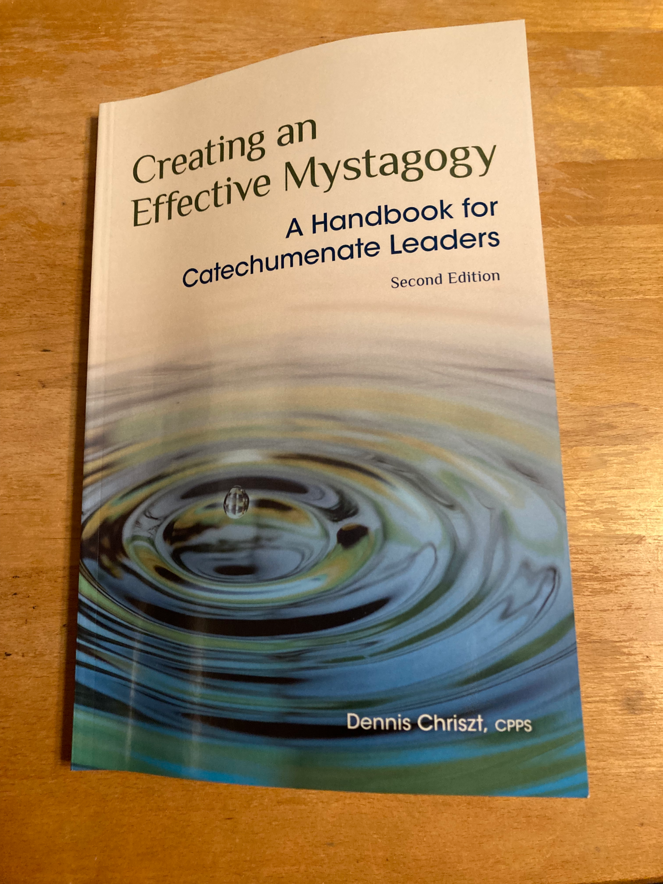

Slide 11
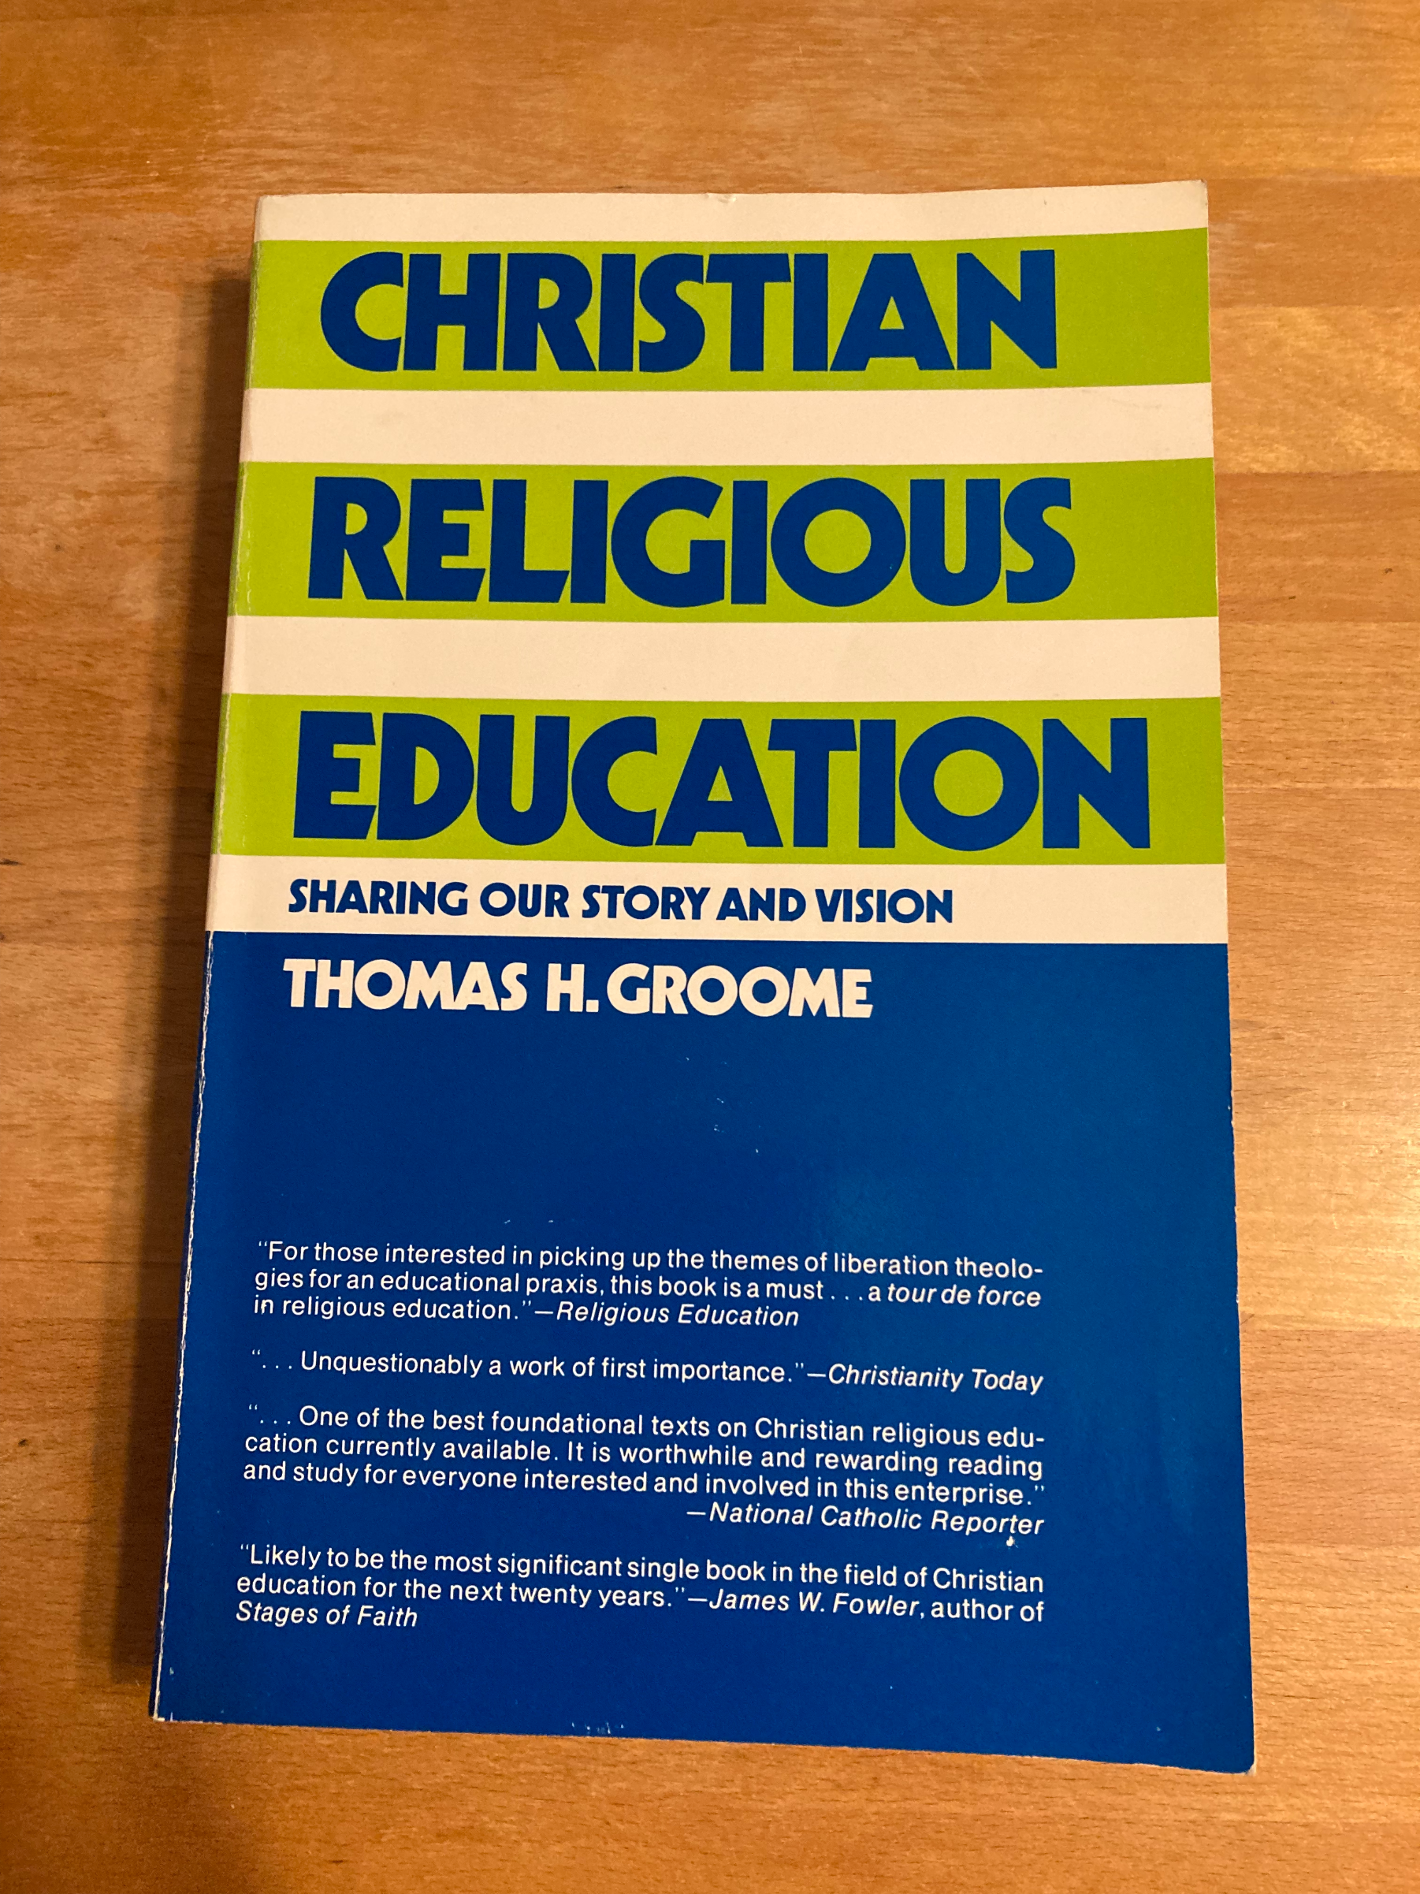

Slide 12
Movements of Shared Christian Praxis
Step 1: Expressing your own story, reality as you see it
Step 2: Critical and shared reflection on
your story/experience
Step 3: THE STORY & VISION of the faith community
(Scripture & Tradition)
Step 4: Making the faith your own
Step 5: Response, decision, action

Slide 13
What do the words Shared Christian Praxis mean?
Shared – it’s dialogical in nature. It invites people to dialogue with themselves, with others, with the Christian story and vision (Scripture and Tradition) and with God. It is not a lecture.

Slide 14
What do the words Shared Christian Praxis mean?
Christian – includes the entire story of the Judeo-Christian faith tradition: doctrine, liturgy, morality, CST—all of it.
And it includes the vision of the Christian community.
It’s not enough to say, “God is love.” Or “God loves you.” We must add that 5th step which says, “You must learn to love others.” That’s the moral dimension.
It’s not enough to say, “God forgives you without saying “and because God has forgiven you, you must learn to forgive others.”
It’s this vision of the Christian community that Jesus called the Kingdom of God. If we are forming disciples, then they are to become people who live and work for the sake of this vision here and now.

Slide 15
What do the words Shared Christian Praxis mean?
Praxis – an ancient Greek word that describes a process of coming to know by reflecting on life. Socrates wisely said, “An unexamined life is not worth living.” And yet so many in our frenetic culture go from one event, one screen to another without ever pausing to reflect on the meaning of so many events and interactions throughout the day.

Slide 16
3 Convictions of Shared Christ Praxis
1) God is active in our lives and their lives now—not just after baptism God is at least 3 days ahead of us!
2) God reveals God’s self in THE STORY and VISION of the Christian Community. Our history as a people is a source of faith for us—all of it: scripture, tradition, creed liturgy, community, etc.
3) If both are true, then there are 2 major sources for coming to know God:
1. our own story (experience in which God has been and is active)
2. The community’s story
These 2 sources must be placed in dialogue with each other for us to come to what James Westerhoff called “owned faith.”

Slide 17
Reflection Sheet
1. Name three significant experiences in your life—experiences that have had a major impact on you—for example: a major move, marriage, the birth of a child, illness, someone’s death, an inner moment of realization that changed your outlook or way of life.
2. Name or describe some of the feelings which you experienced during each of these times.
3. In what way did you know God as you were going through each of these events? As loving? Guiding? Strengthening, Comforting, Punishing? Absent? Not at all?
4. From where you stand today, do you still think of God’s presence during these times in the same way? If you now think differently, please explain.
5. Are you more likely to be aware of God in times of joy or in times of pain or conflict?
6. Choose one experience that you would be willing to share today.

Slide 18
Reflective Remembrance
Initial Reflection: Describing the Experience
This initial reflection is designed to allow the participants to initially describe the “raw” experience, without much depth or quest for meaning.
1) What did you experience?
2. What touched you about the event/what was your most memorable moment ?
3) In what way were you engaged?
4) How would you describe your feelings at any particular moment?
5) What did you see, hear, smell, taste, feel?

Slide 19
Reflective Remembrance
Secondary Reflection: The Quest for meaning
This second reflection is designed to allow the participants to go beyond the experiential into the worlds of meaning behind the experience.
In what particular way were you struck by God’s presence?
Who was the God you experienced in this moment?
What did this experience say to you about God?
How was the community made present?
Name the symbols in this experience. What did they say to you?

Slide 20
Reflective Remembrance
Sharing the Christian Vision
In dialogue with the experience, mention and highlight the relevant aspect of the Tradition, always using the experience and the reflection upon that experience as a starting point.
Example: “When I looked at the font, it seemed like I could drown in there.” “Yes, you are right, our faith teaches us that baptism is a dying to something new.”

Slide 21
Reflective Remembrance
Change for the sake of mission
What difference did all this make?
How has the event shaped the lives and future actions of the participants?
Who needs to hear what you experienced/felt?
What are you going to do this week in response?

Slide 22
Reflective Remembrance
(simplified by Chriszt)
What did you experience?
What does it mean?
Whare you going to do about it?

Slide 23
Mystagogy in the Rite
The third step of Christian initiation, the celebration of the sacraments, is followed by the final period, the period of postbaptismal catechesis or mystagogy. This is a time for the community and the neophytes together to grow in deepening their grasp of the paschal mystery and in making it part of their lives through meditation on the Gospel, sharing in the eucharist, and doing the works of charity. #244

Slide 24
Mystagogy in the Rite
The neophytes are, as the term “mystagogy” suggest, introduced into a fuller and more effective understanding of mysteries through the Gospel message they have learned and above all through their experience of the sacraments they have received. #245

Slide 25
Mystagogy in the Rite
… The period of postbaptismal catechesis is of great significance for both the neophytes and the rest of the faithful. Through it the neophytes, with the help of their godparents, should experience a full and joyful welcome into the community and enter into closer ties with the other faithful. #246

Slide 26
Mystagogy in the Rite
Since the distinctive spirit and power of the period of postbaptismal catechesis or mystagogy derive from the new, personal experience of the sacraments and of the community, its main setting is the so-called Masses for neophytes, that is, the Sunday Masses of the Easter season. #247

Slide 27
Mystagogy in the Rite
All the neophytes and their godparents should make an effort to take part in the Masses for the neophytes and the entire local community should be invited to participate with them. Special places in the congregation are to be reserved for the neophytes and their godparents. The homily and, as circumstances suggest, the general intercessions should take into account the presence and needs of the neophytes. #248

Slide 28
Mystagogy in the Rite
To close the period of postbaptismal catechesis, some sort of celebration should be held at the end of the Easter season near Pentecost Sunday;#249
On the anniversary of their baptism the neophytes should be brought together in order to give thanks to God, to share with one another their spiritual experiences, and to renew their commitment. #250

Slide 29
Mystagogy in the Rite
To show his pastoral concern for these new members of the Church, the bishop, particularly if he was unable to preside at the sacraments of initiation himself, should arrange, if possible, to meet the recently baptized at least once in the year and to preside at a celebration of the Eucharist with them. #251

Slide 30
Mystagogy in the Rite
National Statutes:
After the immediate mystagogy or postbaptismal catechesis during the Easter season, the program for the neophytes should extend until the anniversary of Christian initiation, with at least monthly assemblies of the neophytes for their deeper Christian formation and incorporation into the full life of the Christian community.

Slide 31
Mystagogy in the Rite
#244-251
Community and Neophytes together
Deepen their grasp of Paschal Mystery
Meditate on the Gospel
Sharing in the eucharist
Doing works of charity
Main setting are the Sunday Masses of Easter
Special places reserved
Homily and general intercessions take note
Hold a celebration at the end of the Easter Season
Gather the neophytes on the anniversary of their baptism
Meet the bishop once
National Statutes:
Monthly gatherings for a year

Slide 32
Issues in practice
Ritually impoverished period
Introduction does not give much information about
what is supposed to happen during this time.
Rite presumes that parishes have regular meditation on the Gospel, ongoing faith formation, and opportunities for outreach.
How we view mystagogy
The initiation journey really never comes to an end.
No mystagogical preaching
The celebration of Sundays at parishes . . . Sunday must be worth remembering.
Team is tired – have team members that are responsible for the 50 days of Easter and beyond.

Slide 33
making the most of mystagogy
Have the newly initiated give a witness talk at Mass.
Have the newly baptized wear their white garments throughout the Easter season.
If the sprinkling rite occurs, have the newly initiated assist by carrying the water bowl.
The homily will take into account their presence and how the Sunday scriptures speak to their experience of initiation.
The profession of faith will be introduced as a renewal of everyone’s Baptismal covenant.
In the general intercessions at least one intention is for the newly baptized and newly received.
Have the newly initiated bring up the gifts.
Ask the presider to include the special memento for the newly initiated in the Eucharistic Prayer.

Slide 34
The mystagogical parish
(from Creating an Effective Mystagogy – Dennis Chriszt – p. 11)
"The rite presumes that parishes are mystagogical communities—communities where the mysteries are not only celebrated, but where the mysteries are appreciated and meditated upon, and where the mysteries send people forth to continue the mission of Jesus Christ to establish the reign of God here on earth today. Mystagogical communities do not only meditate on the Gospel during the Easter season. They do not only share the Eucharist at the Masses of the neophytes. They do not only engage in acts of charity from Easter until Pentecost or during the first year of one’s membership in the Church.

Slide 35
The mystagogical parish (continued)
Mystagogical communities do all of these things all of the time. In mystagogical communities, the Word of God is not only proclaimed and mediated upon, it is lived out daily in the lives of the community. In mystagogical communities, people do not need to be reminded that the Sunday Eucharist is a celebration. They celebrate the real presence of Christ in their midst every time two or more of their members are gathered.

Slide 36
The mystagogical parish (continued)
In mystagogical communities, people don’t have to say over and over again, “We are a community.” Anyone who looks at the parish can tell it is a community. In mystagogical communities, everyone knows they are ministers on mission, everyone knows that they have been sent by Christ to proclaim the good news of salvation, everyone knows that “the Reign of God is in our midst.” (Chriszt, p. 11)

