Slide 1
WELCOME
RCIA OPEN FORUM
“RCIA Adapted for Children”
Notes:
Track 4 Page 117

Slide 2
RCIA OPEN FORUM RCIA Adapted for Children
OPENING PRAYER
God who calls us to Him,
We thank you for gathering us together.
Help us to grow in knowledge and wisdom so we bring the children closer to You. May our minds and hearts be open today and every day.
Inspire us to share our gifts and love with the children we serve so they come to know You—Father, Son, and Holy Spirit—and receive the Sacraments of Initiation.
May our witness to the Paschal Mystery and living out our baptismal mission shine a light on the children and families that come to us, so the Body of Christ can grow bigger and stronger.
In Jesus’ name, we pray. Amen.
Notes:
Track 4 Page 117

Slide 3
RCIA OPEN FORUM RCIA Adapted for Children
OBJECTIVES
To embrace the Paschal Mystery as the heart of Initiation Ministry and Mission
To experience gradual, continuous transformation from Head→Heart→Mission
To encounter the Rites fully up to and including Baptism, Confirmation, and Eucharist
To form disciples (not theologians)
To commission the parish community as apostolic witnesses in the Body of Christ (Acts 2:42)
Notes:
Track 4 Page 117

Slide 4
RCIA OPEN FORUM RCIA Adapted for Children
APPLYING THE VISION OF
THE RITE OF
CHRISTIAN INITIATION
ONE RCIA
Notes:
Track 4 Page 117

Slide 5
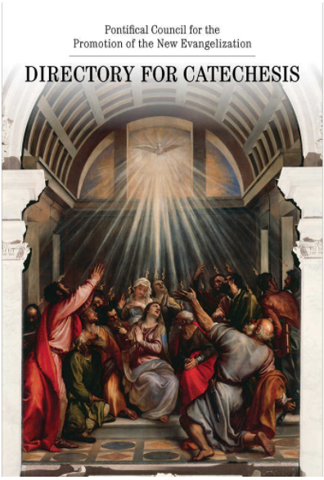
RCIA OPEN FORUM RCIA Adapted for Children
CATECHUMENAL NATURE:
DIRECTORY FOR CATECHESIS
Witness
Kerygma
Evangelization
SYNOD: “Journeying
Together”
Notes:
10-01n

Slide 6
RCIA OPEN FORUM RCIA Adapted for Children
PARAGRAPH 9
. . . . the people of God, as represented by
the local Church, should understand and
show by their concern that the initiation of
adults is the responsibility of all the baptized.
(Ad gentes, 14)
Notes:
Track 4 Page 117

Slide 7
RCIA OPEN FORUM RCIA Adapted for Children
PARAGRAPH 244
. . . . Grow in deepening their grasp of the Paschal
Mystery and in making it part of their lives through
meditation on the Gospel, sharing in the Eucharist, and
doing the works of charity.
Conversion & Transformation
Attending Mass
Discipleship
Living a Catholic lifestyle
Notes:
Track 4 Page 117

Slide 8
RCIA OPEN FORUM RCIA Adapted for Children
READINESS
It takes as long as it takes
It is NOT just checking boxes
School year model is not conducive for initiation
Notes:
Track 4 Page 117

Slide 9
RCIA OPEN FORUM RCIA Adapted for Children
PARAGRAPH 75
Catechesis—Word and Tradition (learning about and growing in the Catholic faith)
Community—Participation in the Catholic way of life (prayer and good works)
Liturgy & Worship (Mass and other opportunities)
Mission—spreading the Good News
Notes:
Track 4 Page 117
10-1h

Slide 10
RCIA OPEN FORUM RCIA Adapted for Children
PARAGRAPH 154
. . . . Show your elect the way of
salvation in the Holy Spirit, that they may
come to worship the Father in truth
Notes:
Track 4 Page 117

Slide 11
RCIA OPEN FORUM RCIA Adapted for Children
IT TAKES A VILLAGE
Child / Teen
Family
Community
RCIA Team / Catechists / Pastors / Deacons / Ministers
Notes:
10-01m

Slide 12
RCIA OPEN FORUM RCIA Adapted for Children
FORMATION and MODELS
Goal of Religious Education = Sacramental Reception
Goal of RCIA = Initiation into the life of the Catholic Church
Notes:
10-01n

Slide 13
RCIA OPEN FORUM RCIA Adapted for Children
MODELS: PROS and CONS
Diamond Standard: Family/Intergenerational
Platinum Standard: Children Only Catechumenate
Gold Standard: Religious Education w/Rites
Silver Standard: Catholic School Plus
Bronze Standard: Traditional Religious Education / Youth Ministry
Notes:
10-01s

Slide 14
RCIA OPEN FORUM RCIA Adapted for Children
LITURGICAL RITES:
ONE BAPTISM—TWO RITES
Order of Baptism of Children (Infant Rite)
Rite of Christian Initiation of Adults
Canon Law & National Statutes for the Catechumenate
Canon 842.2 & Statute 14
Canon 852.1 & Statute 18
Canon 883.2, 885.2 & Statute 13 & 35
Notes:
10-01s

Slide 15
RCIA OPEN FORUM RCIA Adapted for Children
RCIA RITES
Rite of Acceptance
Rite of Election
Scrutinies or Penitential Celebration
Minor Rites
Blessings
Exorcisms
Presentations
Preparation Rites
Rites of Initiation: Baptism, Confirmation, Eucharist
Notes:
10-01s

Slide 16
RCIA OPEN FORUM RCIA Adapted for Children
CLOSING / SUMMARY
Initiation of Children, Teens, and Adults is one RITE
Better to do something rather than nothing
Flexibility: different models but follow Canon Law, National Statutes, RCIA Rites
Do the Liturgical Rites with Children
Readiness: Conversion and Discipleship
Rite of Initiation: Baptism, Confirmation, Eucharist
Notes:
10-01s

Slide 17
RCIA OPEN FORUM RCIA Adapted for Children
CODE OF CANON LAW
842 §2 The sacraments of baptism, confirmation and the blessed Eucharist so complement one another that all three are required for full Christian initiation.
883 §2 The priest who presides at the reception of these young children of catechetical age receives from the law the faculty to confirm them.
885 §2 Those who have the faculty to confirm are bound to exercise it.
NATIONAL STATUTES FOR THE CATECHUMENATE
Notes:
10-03a

Slide 18
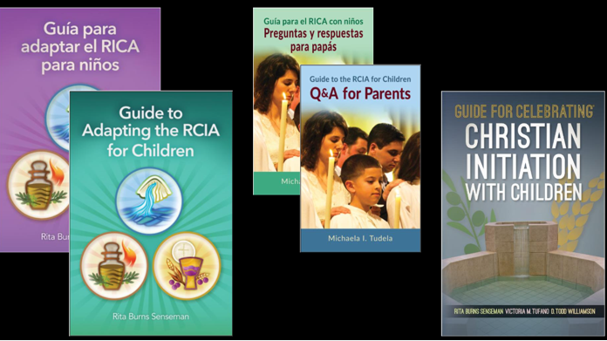
RCIA OPEN FORUM RCIA Adapted for Children
RESOURCES from LTP
Senseman, Rita Burns. Guide to Adapting the RCIA for Children.
Tudela, Michaela I. Guide to the RCIA for Children: Q&A for Parents.
Senseman, Rita Burns. Guide for Celebrating Christian Initiation with Children.
Notes:
10-01s

Slide 19
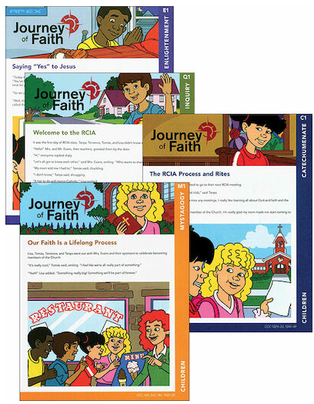
RCIA OPEN FORUM RCIA Adapted for Children
RESOURCES from Liguori
Journey of Faith for Children.
(English & Spanish)
Notes:
10-01s

Slide 20
RCIA OPEN FORUM RCIA Adapted for Children
QUESTIONS
Notes:
10-03a

Slide 21
RCIA OPEN FORUM RCIA Adapted for Children
CLOSING PRAYER
Dear Lord of all, we praise You, honor You, and thank You.
Bless us as we leave this gathering, armed with understanding, thoughts, and ideas to serve these catechumens, candidates, and families.
Although it sometimes seems impossible, we know that with You all things are possible. "Show me your ways, LORD, teach me your paths. Guide me in your truth and teach me, for you are God my Savior, and my hope is in you all day long.“ (Psalm 25:4-5)
May the families we touch grow stronger in their faith and shine their light for others.
We pray in the name of the Father, the Son, and the Holy Spirit. Amen.
Notes:
Track 4 Page 117

Slide 22
RCIA OPEN FORUM RCIA Adapted for Children
CONTACT INFO
DARLEINE ARCE (706) 302 – 7075
St. Philip Benizi, Jonesboro
darce@stphilipbenizi.org
JUDI HORNBACK (219) 746 – 2425
St. Pius X, Conyers
hornback11@sbcglobal.net
CHARLES JONES (404) 277 – 2685
Archdiocese of Atlanta, OFD
cjones1@archatl.com
Notes:
Track 4 Page 117

