Slide 1
Virtual RCIA
Lorraine Miller, Dir. of Faith Formation Darleine Arce, Catechetical Coordinator St. Philip Benizi Catholic Church

Slide 2
Digital Catechesis is here to stay
The digital environment is characteristic of the contemporary world . . . It is no longer merely a question of ‘using’ instruments of communication, but of living in a highly digitized culture that has profound impact on ideas of time and space, on our self-understanding, our understanding of others and the world, and our ability to communicate, learn, be informed, and enter into relationships with others.
Christus Vivit 86
Microsoft Teams, for example, jumped from 20 million users in January this year to 44 million in March. The number of individuals using Zoom for video and audio meetings, meanwhile, has leapt from 10 million in December 2019 to 300 million four months later. Computer Weekly
Do you plan to continue with a virtual RCIA?
Notes:
While it’s here to stay we also must remember to use it in moderation. Pope Francis also said it’s important “social media never become a threat to the real life relationships by imprisoning us in a virtual reality and isolating us from the very real relationships that challenge us to grow.”
Who is planning to continue a digital RCIA option or a hybrid?

Slide 3
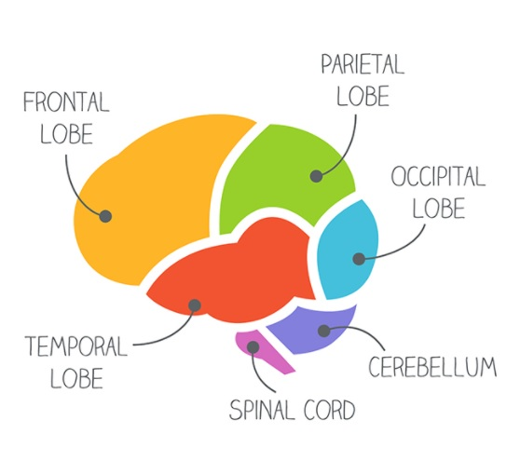
But are our brains wired for constant technology?
The challenge is that people who are used to having the boundaries between their work and home life more clearly defined are finding the two blurring together more and more, not least as “people think you’re always on”.
Another related consideration involves the small, daily interactions with colleagues that fail to take place in a remote setting. Such interactions are not only important socially, but also provide people with crucial breaks to give their brains time to absorb and consolidate information, thereby preventing exhaustion.
Do you call your candidates, catechumen, and parishioners to check on them?
Notes:
Darleine Forebrain & Hindbrain

Slide 4
Keep in Mind: Zoom Fatigue is real
A further challenge is so-called “Zoom fatigue”, in which people find themselves more exhausted at the end of their working day than usual because of endless video calls.
Notes:
Every 4 or 5 sessions not catechetical. Find a new way to engage with the participants. Asking them to share their bio.
https://www.computerweekly.com/feature/Collaboration-technology-breeding-burnout-keep-it-real

Slide 5
The best solution is a hybrid approach.
Humans communicate even when they’re quiet. During an in-person conversation, the brain focuses partly on the words being spoken, but it also derives additional meaning from dozens of non-verbal cues, such as whether someone is facing you or slightly turned away, if they’re fidgeting while you talk, or if they inhale quickly in preparation to interrupt.
For somebody who’s really dependent on those non-verbal cues, it can be a big drain not to have them.
A.G.E.S. method for online learning (Attention, Generate, Emotion, Social)
What are some non-digital ideas you have?
Notes:
Offering opportunities to gather at the monastery or a park Virtual Tours. Participants watch and come back to share. https://www.p4panorama.com/panos/HOLYLAND/ http://www.museivaticani.va/content/museivaticani/en/collezioni/musei/tour-virtuali-elenco.html Bring in a witness: someone who has been.
Currently offer RCIA 2x a week. May meet in person one day and offer virtual the other day.
https://www.nationalgeographic.com/science/2020/04/coronavirus-zoom-fatigue-is-taxing-the-brain-here-is-why-that-happens/

Slide 6
IT’S ALL ABOUT RELATIONSHIP
RCIA is about an encounter with Christ. This is best done in relationship.
...Catechesis cannot be carried out solely by using digital tools, but by offering spaces for experiences of faith.
Directory for Catechesis 371
Share your favorite ice breaker in the chat.
Notes:
Incorporate time for gathering. Ice breaker activity. Build it in at beginning. Open the session early - announce that. Don’t use waiting room feature. Offer times in breakout rooms to check in with your sponsor at the beginning or end of sessions. Share phone numbers. Call your candidates and catechumens.

Slide 7
SUPPORTING YOUR TEAM, SPONSORS, CATECHISTS IN AN ONLINE PROCESS
Pray with them and for them!
Build relationships
Communicate consistently
Set clear expectations
Provide training for participants/sponsors/teams. Allow Teams to practice in a hands-on way
Offer non-digital options
What are some other ways you support your team?
Notes:
AND, when working with teams, I would add that there should be some way for the team that is hosting the session to practice their TIMING. What are the cues that you will use when your RCIA catechist is passionately sharing and leading a discussion but really it’s time to move on. With the virtual platforms, it’s very difficult to steer conversation in a new direction without coming across rude by interrupting. And not everyone is used to facilitating in such a way that they can read a private message in chat, process it, all the while still talking to participants about an entirely unrelated topic. This requires some finesse.

Slide 8
SAFETY & CONSIDERATIONS FOR VIRTUAL
What are the ages of your participants?
Do you need to obtain parental permission to communicate with minors (teens)?
Will you require parents to be part of that process (for children)?
Have you laid out clear expectations about “showing up” to session?
The Do’s & Don't of Zoom & Sharing online
(the logistics of) Recording Session & saving chats
Me showing up to my RCIA Zoom with my pet.
Notes:
Breakout rooms are like going into a new room.

Slide 9
PLATFORMS (more frequently used)
Name | Cost | Time | # Participants | Complexity | Considerations
Zoom | Free up to 40 mins. Paid versions* ($15+/mo/host) | Free:40 mins. Paid versions* 24 hrs. | Basic= 100 Pro= 100* Business= 300* Enterprise= 500* | Requires some training. Fairly easy to learn. | Login from link (no A/C req.).
Google Meet | Free (or paid: Business & Enterprise) | No limit | Basic=100 Business= 150* Enterprise=250* | Easy. Requires a GSuite email (Gmail or Google account) | Host cannot mute guests mics/videos in large meetings.
GoToMeeting | ($12-$19, depending on monthly vs. annual) | No limit | 150-250 | Similar to Zoom | Allows you to designate co-organizers, like Zoom.
Microsoft Teams | Microsoft Office required | No limit | 300 | Complex. Requires training.
Notes:
Presentation notes:
For Zoom, there are lots of options for add on packages (webinars, large meetings, breakout rooms, etc. Unfortunately, each has its own cost. You could pay anywhere from $20 to $90 on top of your A/C cost per month. The per-month option, however, IS an added benefit. So you aren’t locked into paying for something year-round if you only need it for a few months.

Slide 10
COMMUNICATIONS TOOLS
FREE Text Messaging: WhatsApp OR Messenger Groups OR Remind
WA & Messenger allow longer texts (175+characters) and have functionality for 1-1 video calls. Messenger has “rooms” for multi-people video gatherings. (WA allows for 1-1 video)
All allow for files & media links to be shared.
No screen or presentation sharing on any.
COST- Email Marketing Platforms (MailChimp*, Constant Contact[$20-45/mo], Flocknote[$14/mo])
Allow for files and media to be shared.
Longer messages which can also be sent to cellphones as clickable texts (great for ppl w/o email)
Text-to-join functionality & captures replies in ONE place (so you aren’t trying to find email threads vs. text threads). *Mailchimp has 4 tiers with different costs and they do offer a rate for non-profits. Call to find out!

Slide 11
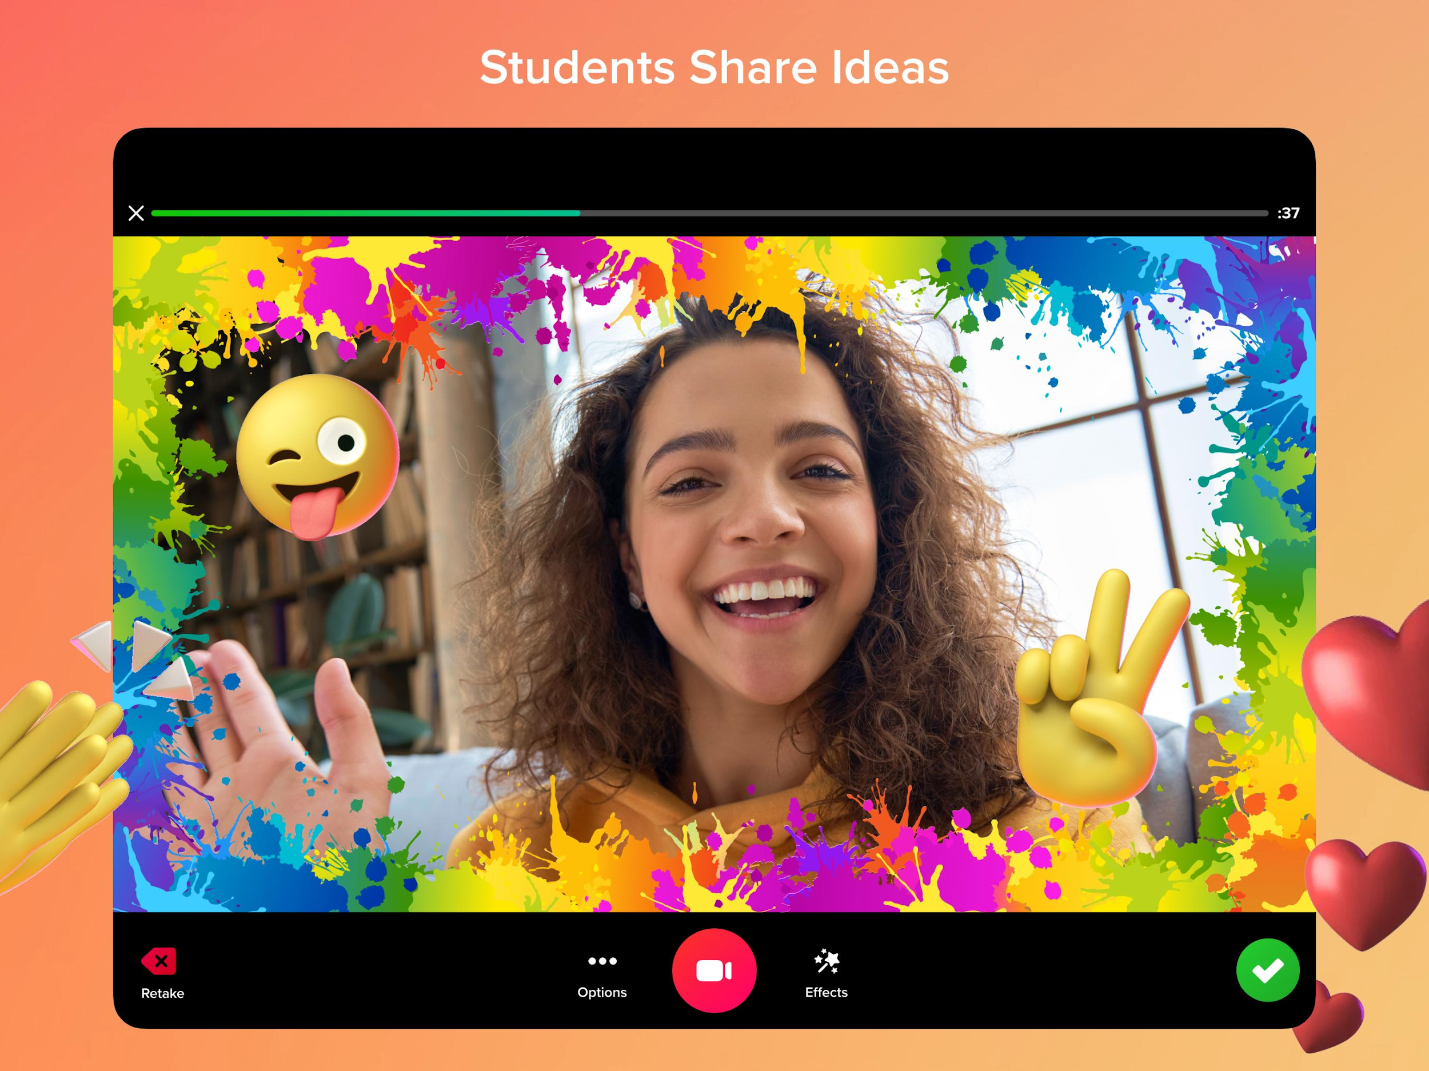
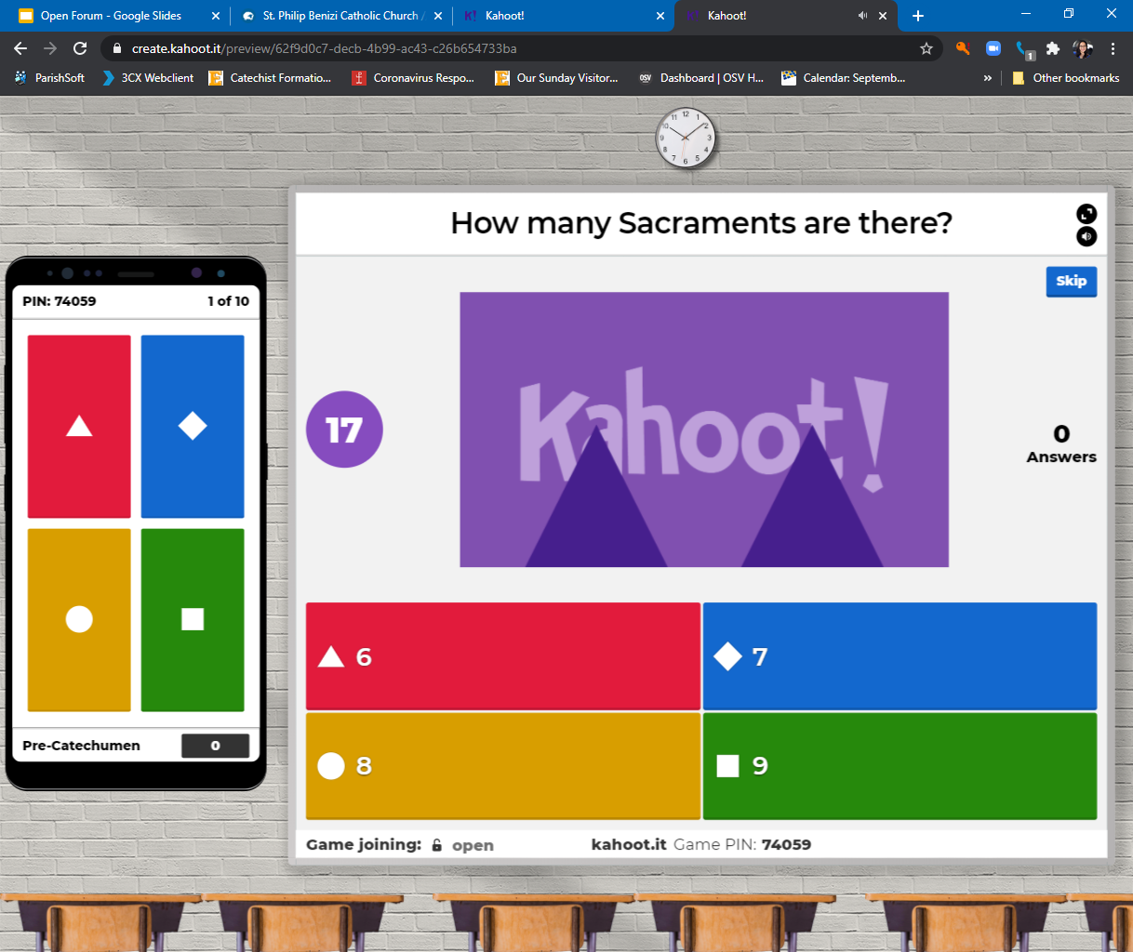
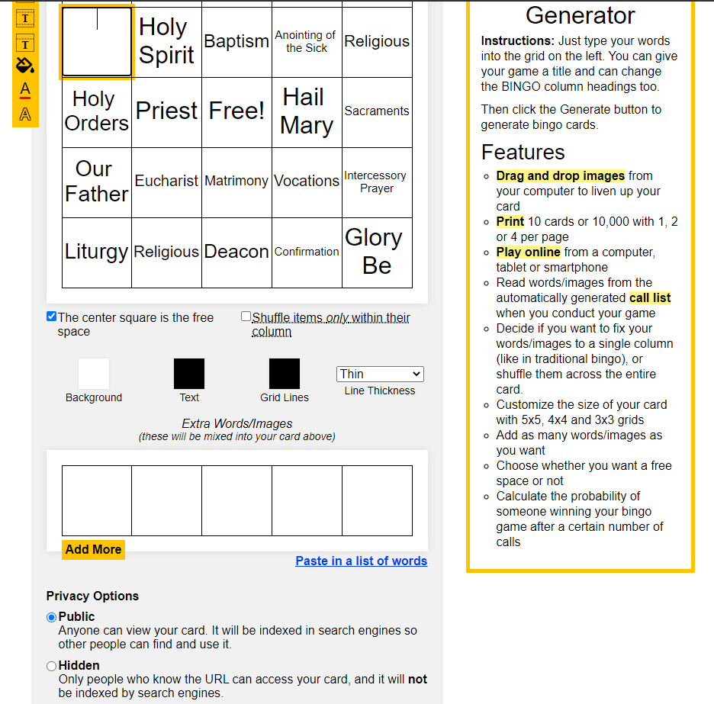
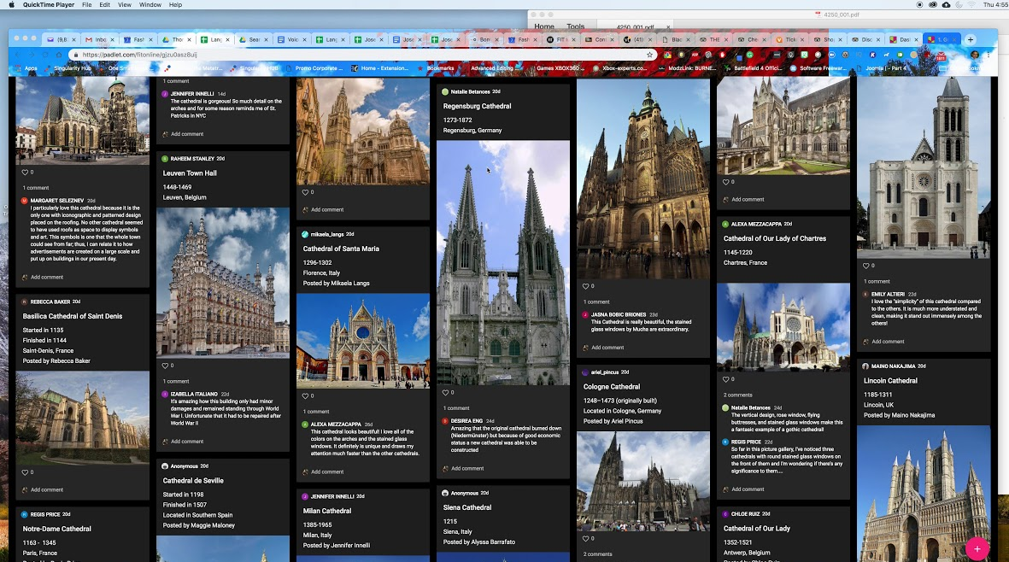
Apps ………….to enhance learning/sharing
Interactive Apps Flipgrid Padlet
Quiz Apps Quizlet Kahoot Moodle Forms (Google)
Game Apps (Online) BingoBaker
Notes:
Flipgrid allows for either recording short videos (up to 10 minutes long) OR for screen recording (for lessons) OR any combination of the above. They even feature whiteboards and blackboards that participants can interact on while they respond to the prompt.
Padlet is a virtual wall that allows people to express their thoughts on a common topic easily. It works like an online sheet of paper where people can put any content (e.g. images, videos, documents, text) anywhere on the page, together with anyone, from any device.One teacher uses padlet as an opportunity for individuals to post questions during a session like the concept of “parking garage” for ideas that you revisit in the last 10 minutes of a session.
Moodle is an open-source teaching platform similar to Google Classroom. Users can create topics and share materials with their participants. The quiz function allows you to create a shared question bank that you can access to create custom quizzes with multiple question types.
BingoBaker.com allows you to create your own cards with a list of words that you provide to the system! Play publicly for free or for $15, you can purchase lifetime access to play through a unique URL linked to your organization. They can play online, simultaneously as you call out words, or the system allows you to play over a set of days.

Slide 12
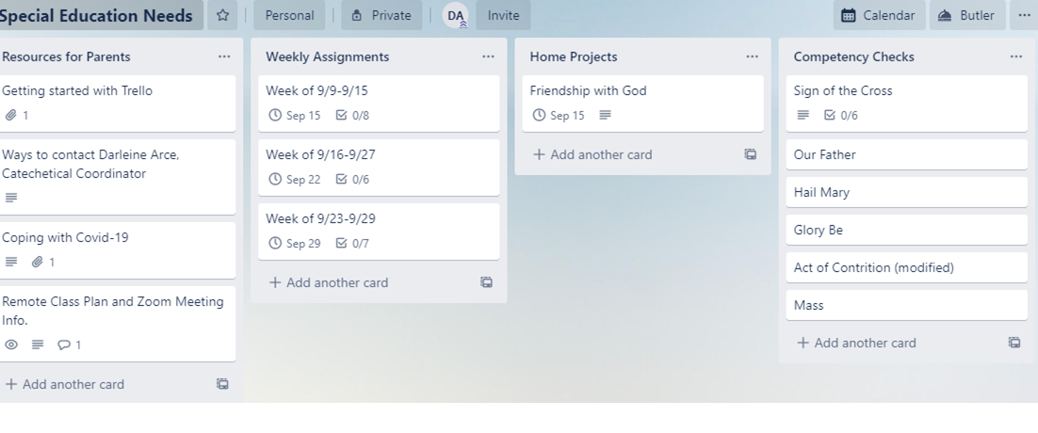
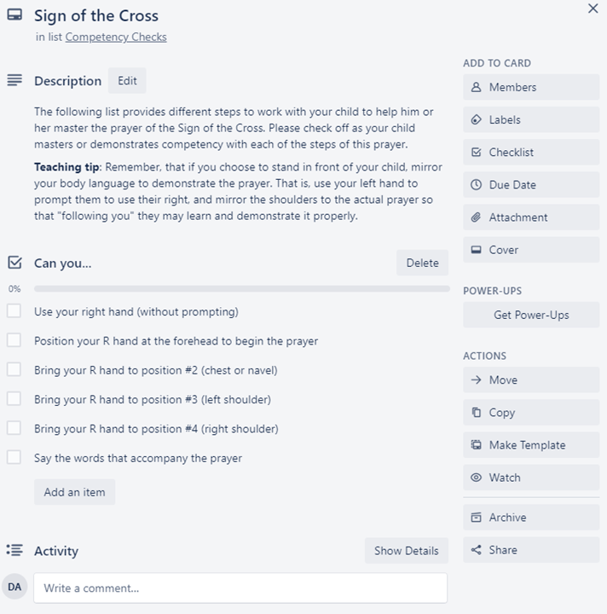
Apps ………….to enhance learning/sharing
Organizational Apps Trello Slack
Notes:
https://www.bitmoji.com/games/

Slide 13
Apps ………….to enhance learning/sharing
Presentation Apps Pear deck Microsoft Powerpoint Google Slides (what we are using) Prezi (presentations, videos, & infographics/social media posts)
Videos: Formed, Youtube, Vimeo
Let your technology work for you, not vice versa!
Have clear objectives in mind about what you want to accomplish and how, then look for tools that can help you achieve it in innovative ways!
Notes:
Each of the presentation type of apps has special integrations. For instance, Peardeck and Google Slides work well together. Zoom & Prezi work well together for simulcasting.
Prezi works well with Google Classroom, but also some social media platforms like facebook and Twitter.
*The main takeaway is to never become frustrated with or overwhelmed by the vast amount of technology out there. Let the tech work for you, NOT you for the tech.

Slide 14
ADDT’L RESOURCES
Apprentices in Faith (digital). http://apprenticesinfaith.com/
Journey of Faith (English subscription available now. Bilingual digital will be available in Sep. 2020). Appropriate for Children, Teen, and Adults.
LTP Training Videos: www.catechumeneon.org
Using Technology in Catechumenal ministry
Breaking Open the Word: https://livingspace.sacredspace.ie/
Praying the Scriptures/Sunday Celebrations (RCL Benziger)- Available in English & Spanish
Teachers Pay Teachers: Cheap and free resources (avail. in digital & print)
Holy Heroes.com
What other resources are you using?
Notes:
Darleine’s note: For Family RCIA, I use a combination of Sunday Celebrations from RCL Benz., along with Gospel Videos from Holy Heroes, and JoF (which I scan in for families until the bilingual subscription becomes available). I created a Google Drive folder for my catechetical team to access these resources (so that I don’t need to remember to email them on a weekly basis). The Gospel videos are available online for free! So JoF is what I scan in each week and email out to families, via Flocknotes, before session so that they can come with questions and ready to share!

Slide 15
Networking
Other s:
Scheduling and doing your interviews?
Are your catechists on board?
How are you organizing your sessions? Is anyone using breakout rooms?
Share the format of your session.

